Slide 1
OCR project update
AI team
23.12.2568

Slide 2
OCR project
Phase 1: Qwen2.5-VL-Instruct for text and table extraction
Phase 2: DeepSeek-OCR for text and table extraction
Phase 3: DeepSeek-OCR to locate bounding box (e.g., MCCS use cases)
Phase 4: DeepSeek-OCR for image description including chart, plot, and trend
In progress
2026
2026

Slide 3
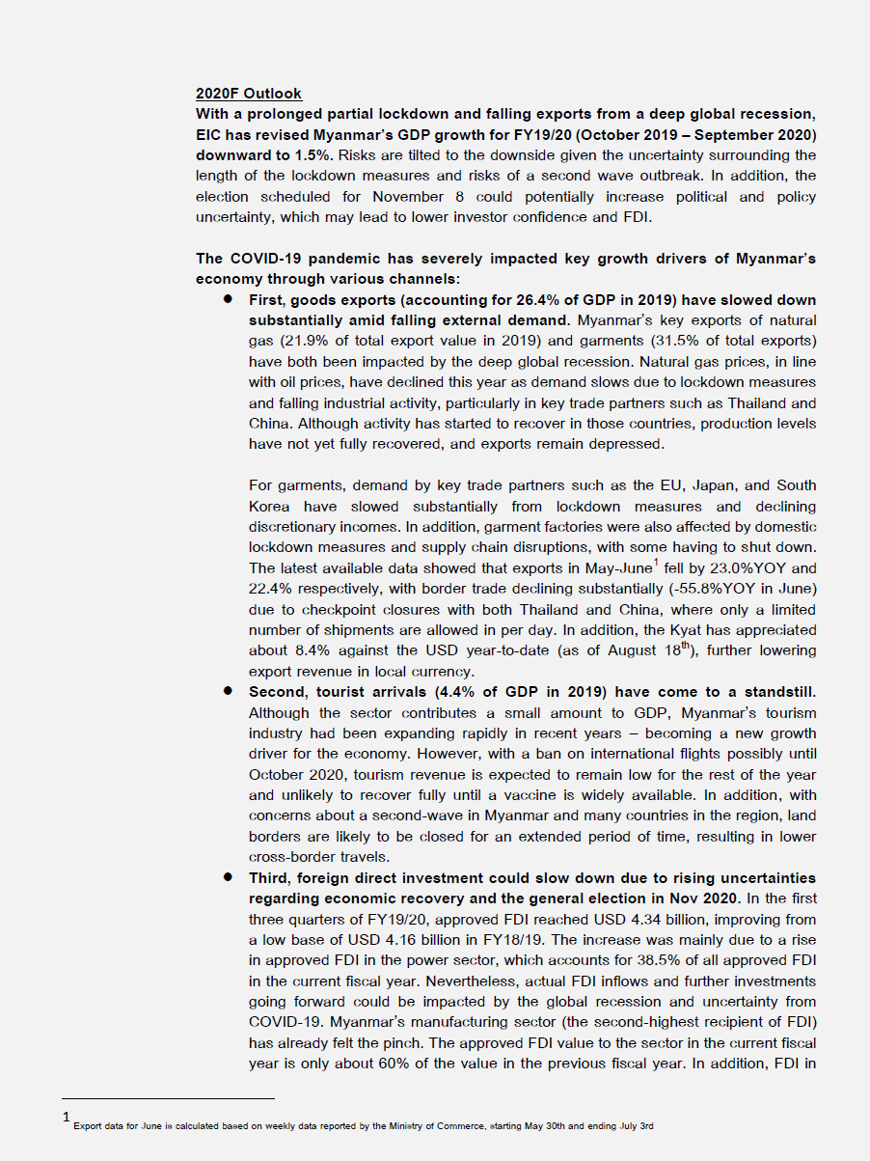
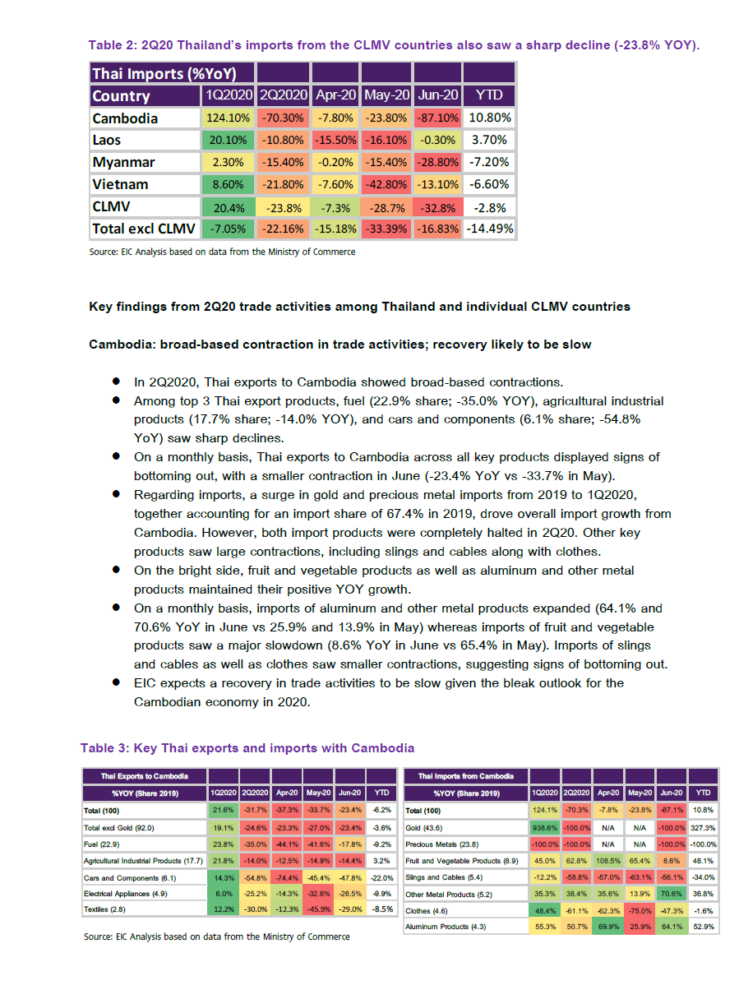
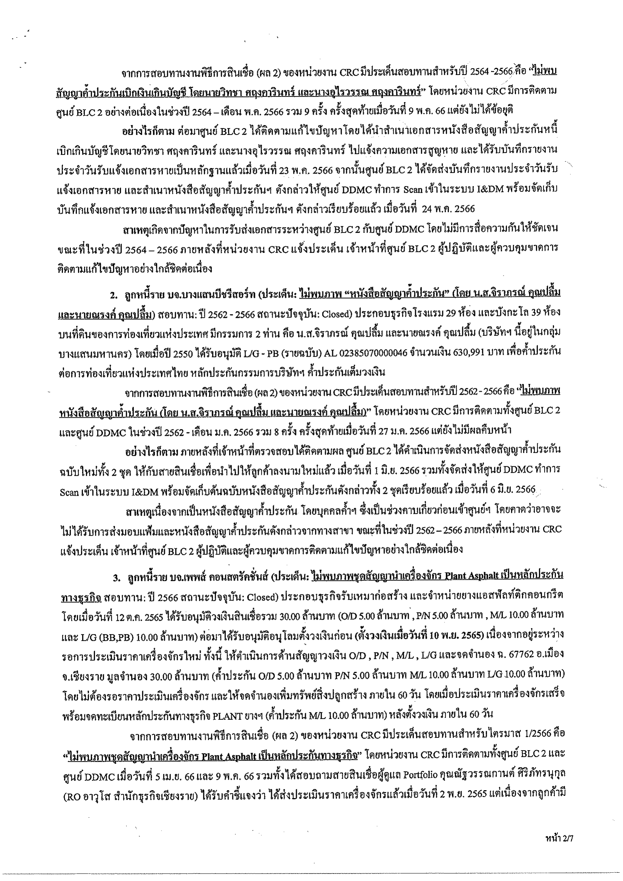
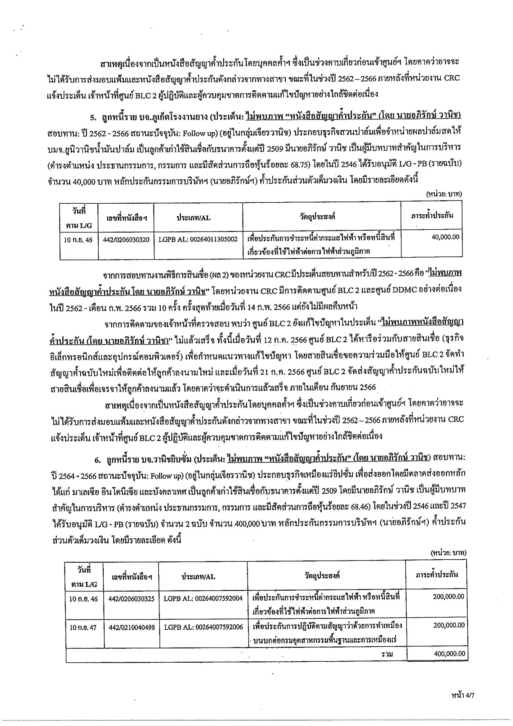
Phase 1: Qwen2.5-VL-Instruct for text and table extraction
Use case: Documents in English and Thai languages
Goal: To extract text and table from document to markdown file

Slide 4
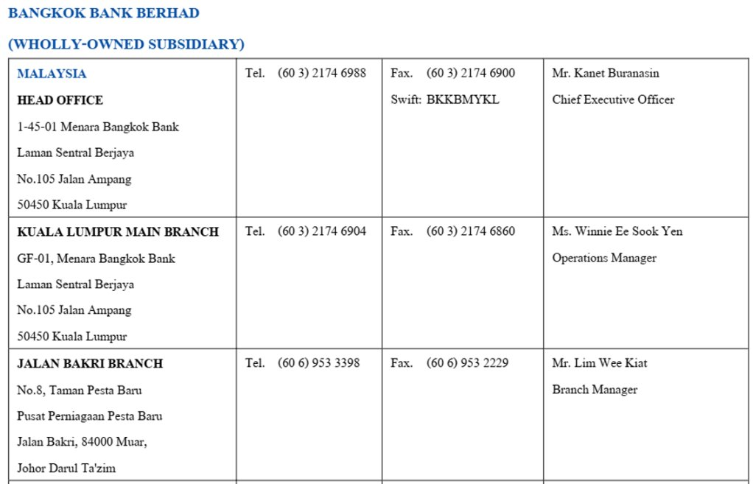
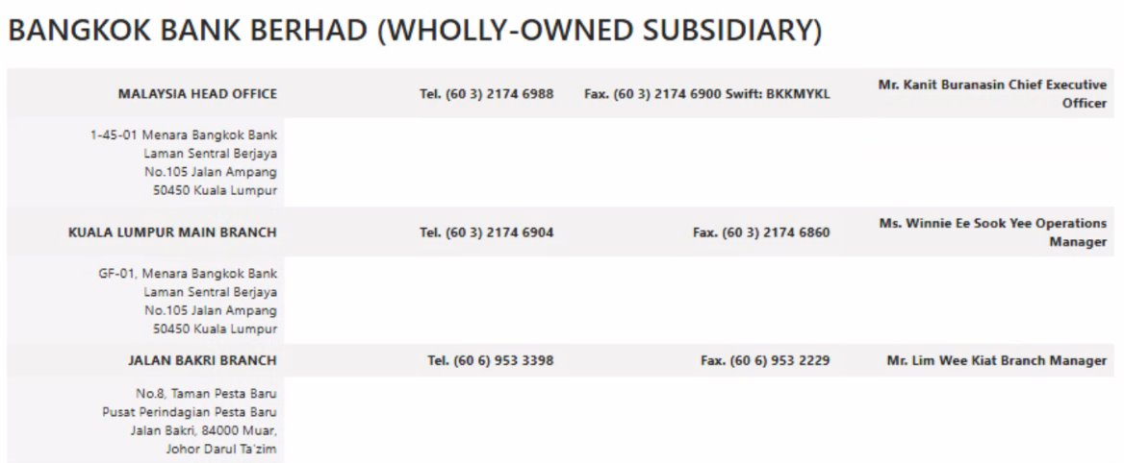
Phase 1: Qwen2.5-VL-Instruct for text and table extraction
Success: General text extraction, merged table, and low-complexity table
Limitation: Distorted document, complex table, and Thai language
Qwen2.5-VL-Instruct result

Slide 5
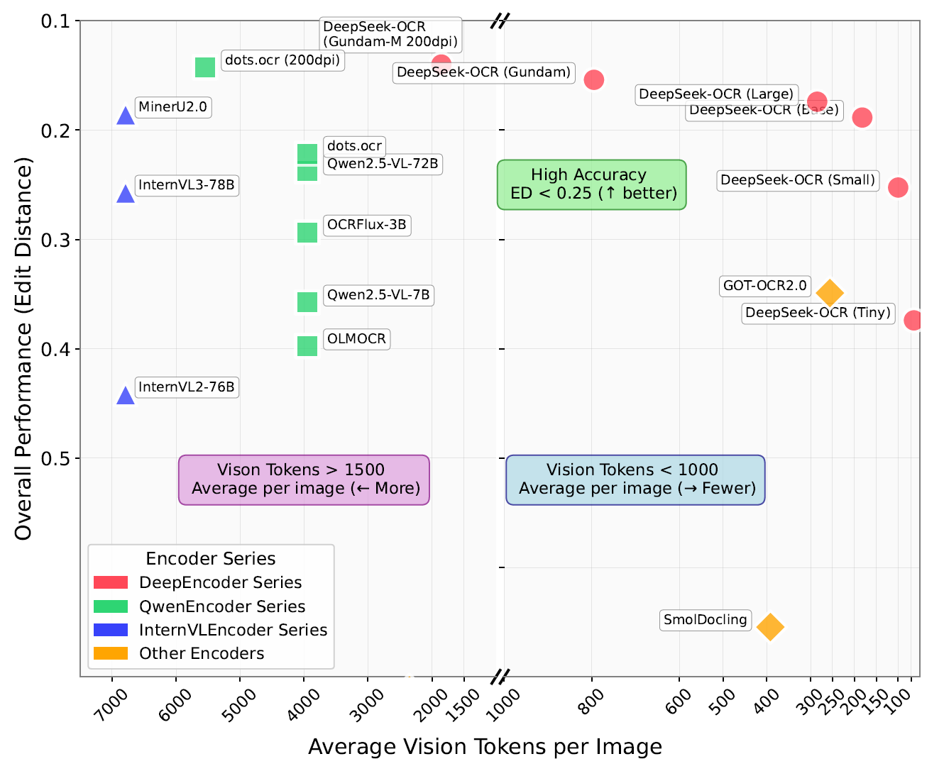
Why DeepSeek-OCR?
Unified workflow: One Model, Many Tasks. DeepSeek can handle OCR, chart analysis, and object detection (bounding box).
Memory save & fast inference: DeepSeek-OCR uses a unique architecture that compresses visual information (images) into few tokens (up to 10x compression).
HaoranWei, Yaofeng Sun, Yukun Li, “DeepSeek-OCR: Contexts Optical Compression”, arXiv preprint arXiv:2510.18234, 2025.

Slide 6
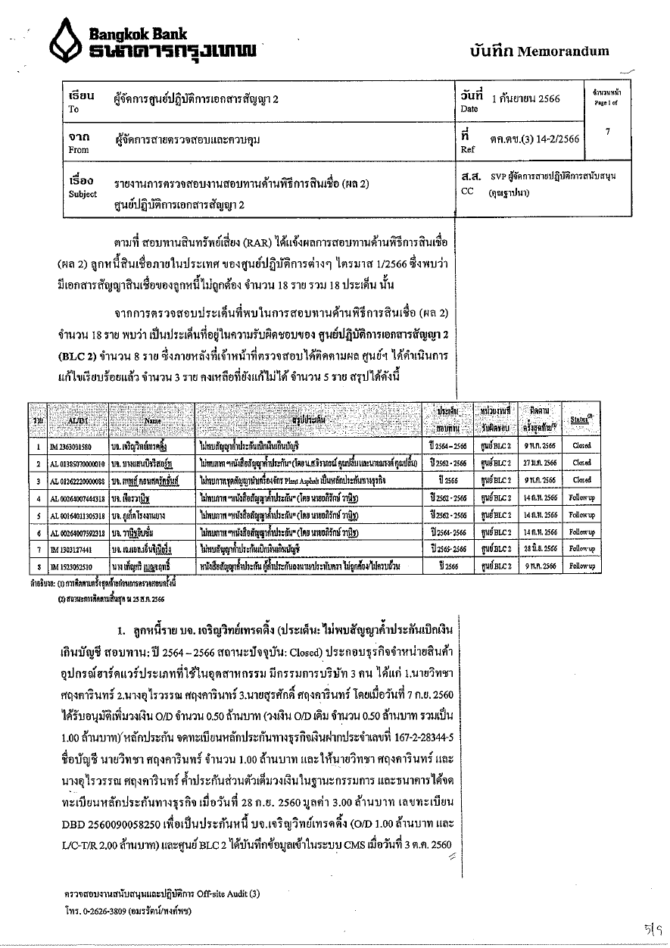
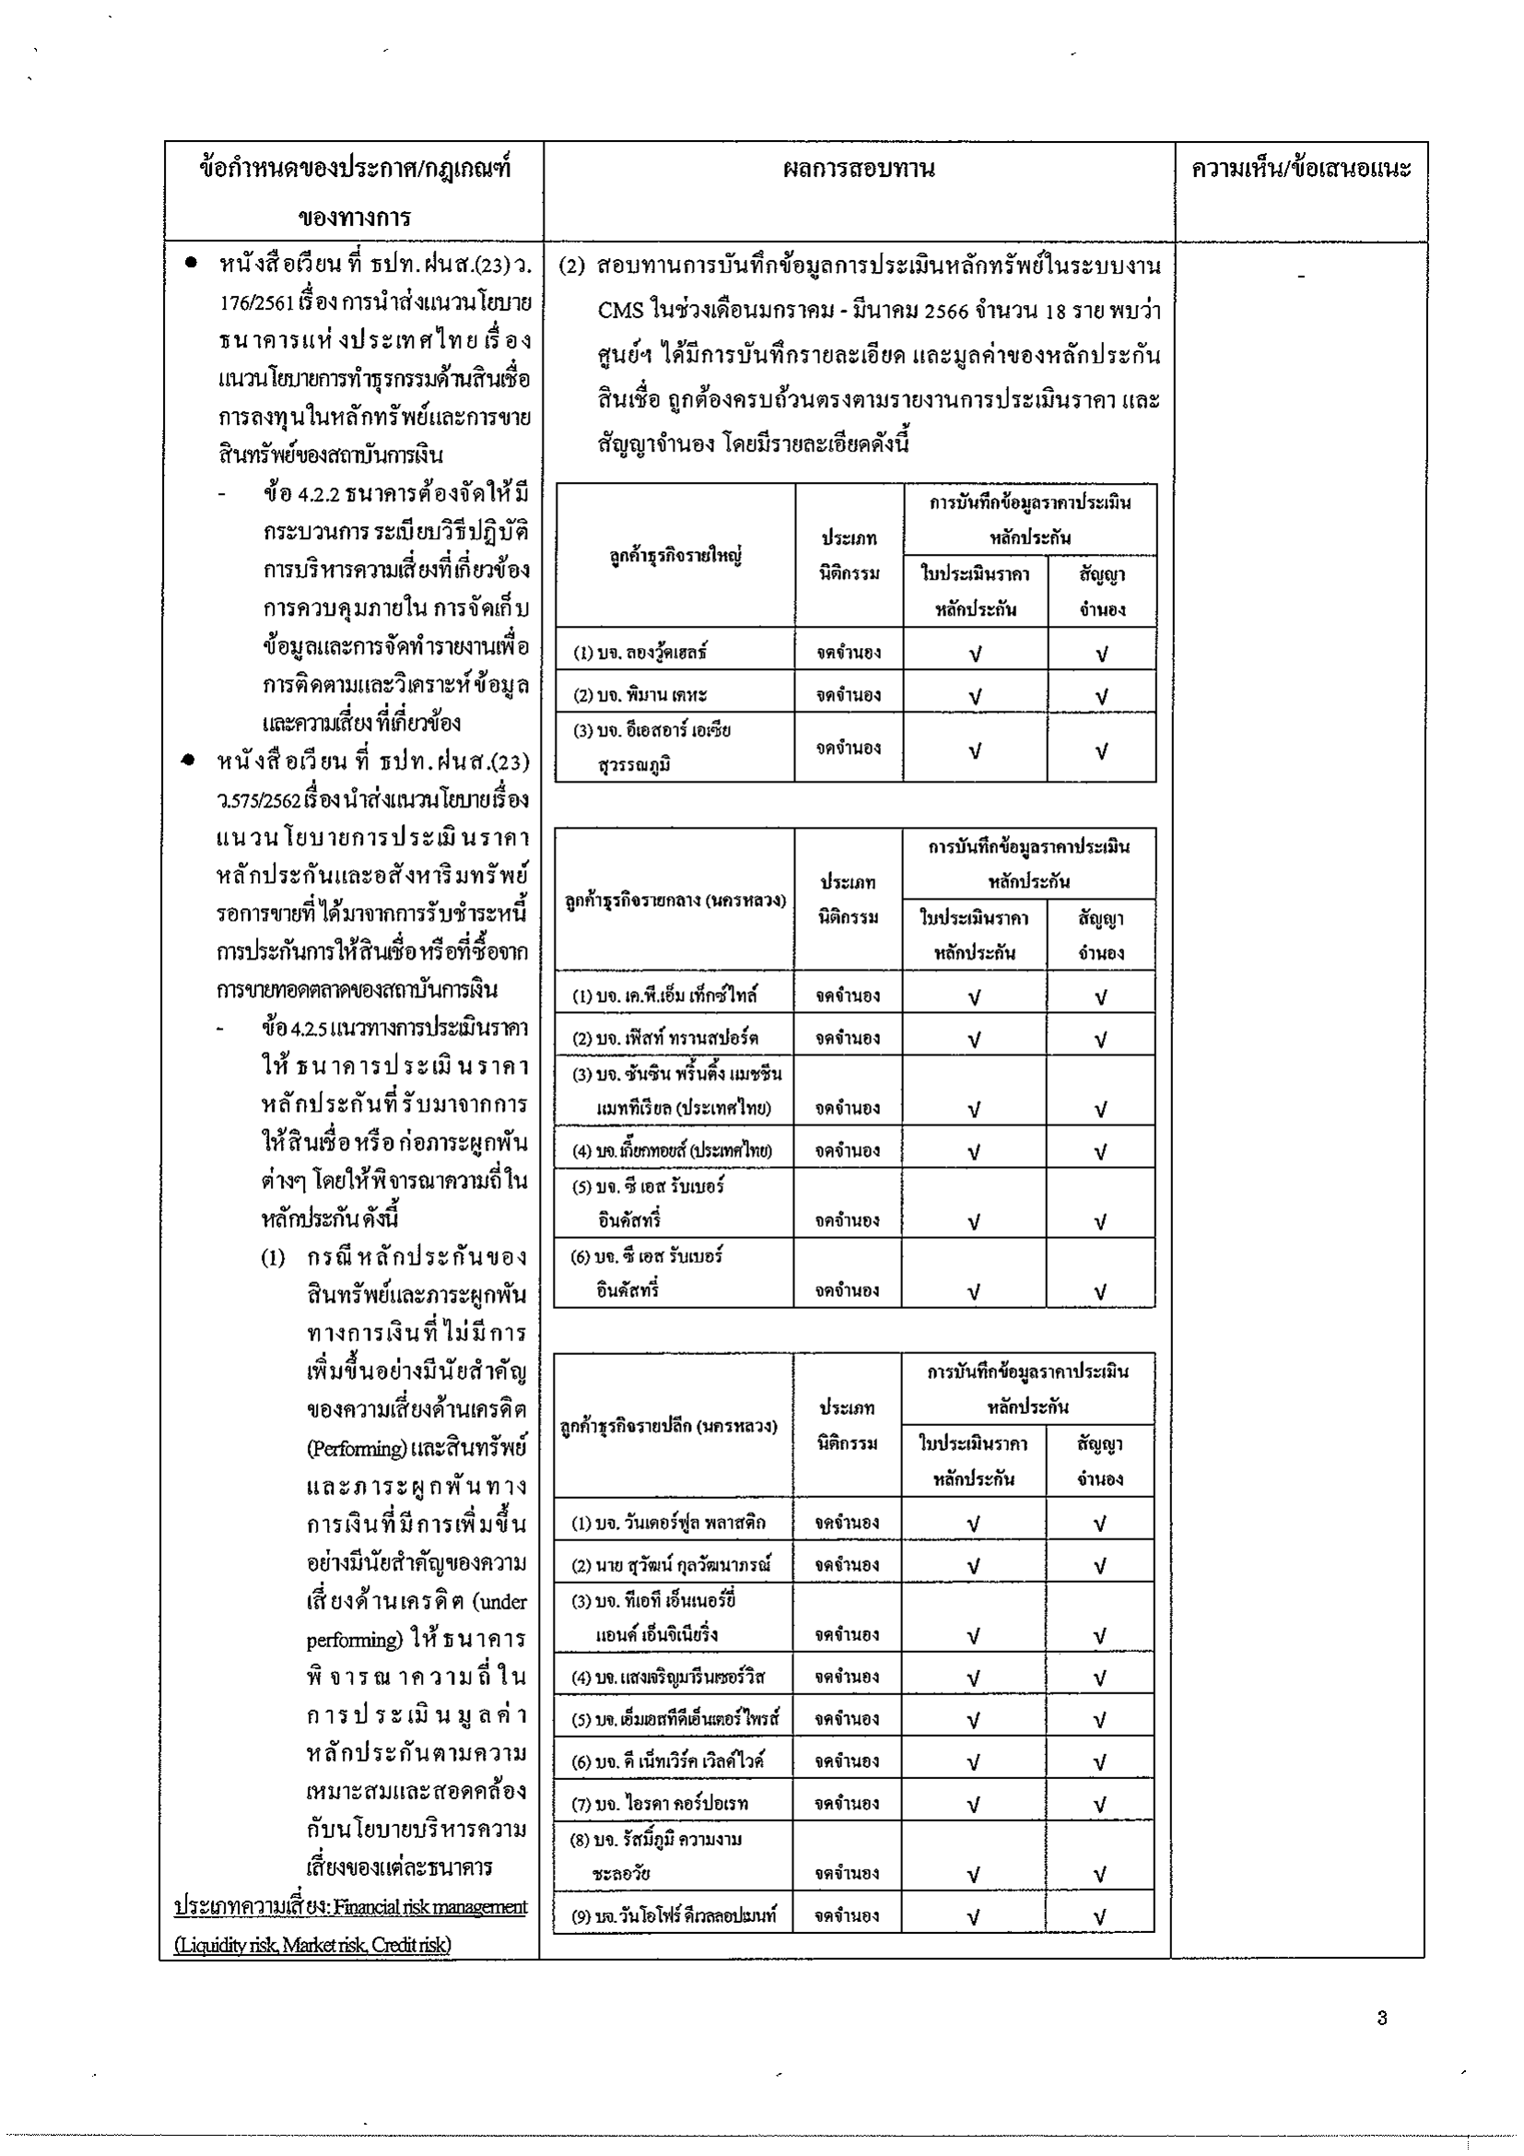
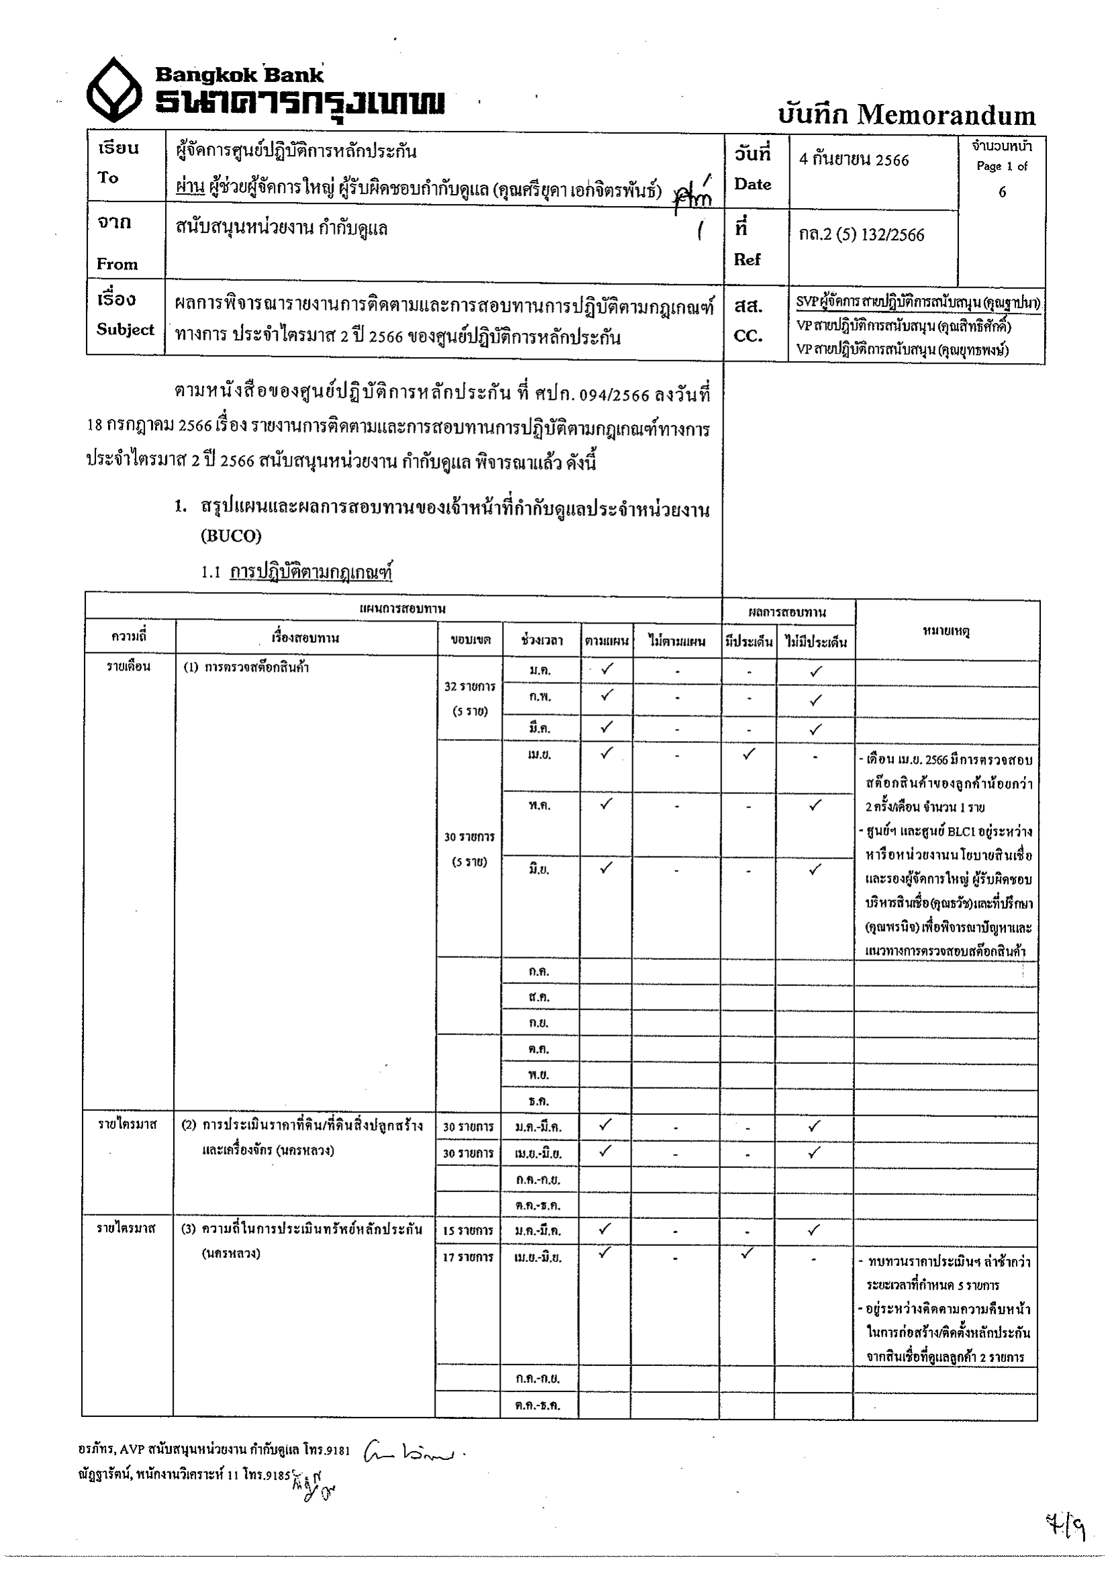
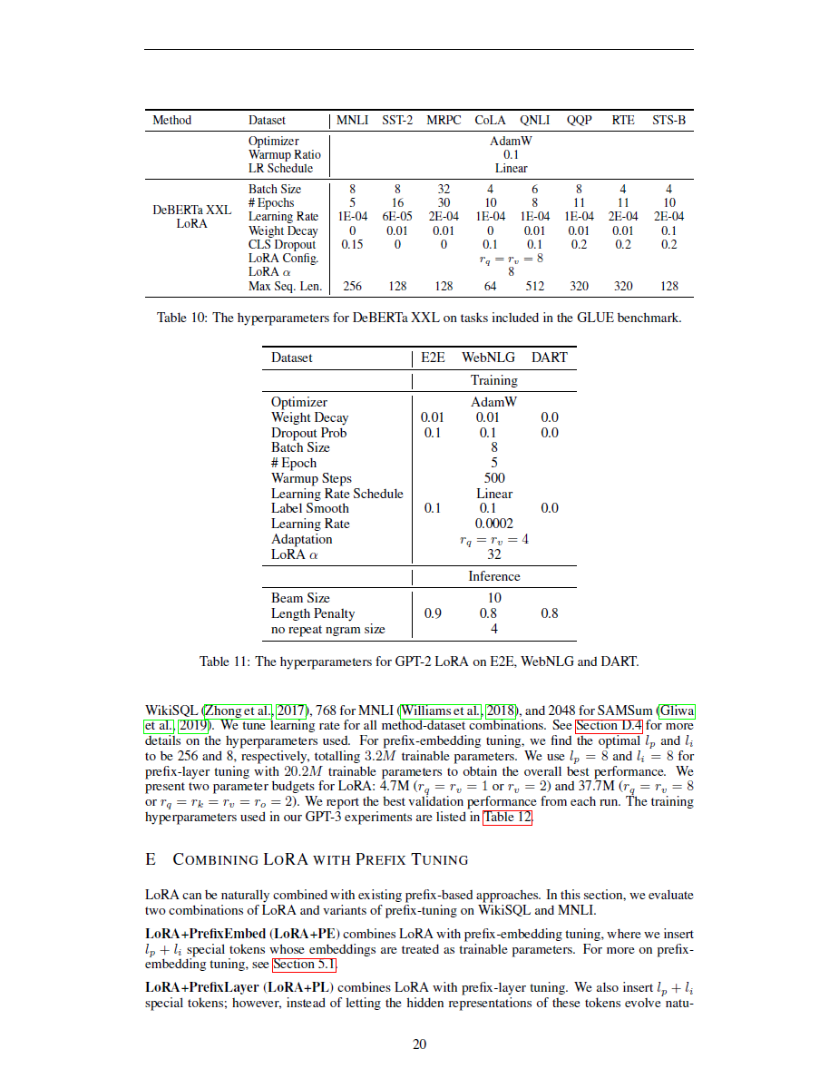
Phase 2: DeepSeek-OCR for text and table extraction
Goal: To capture distorted document, complex table, and Thai language

Slide 7
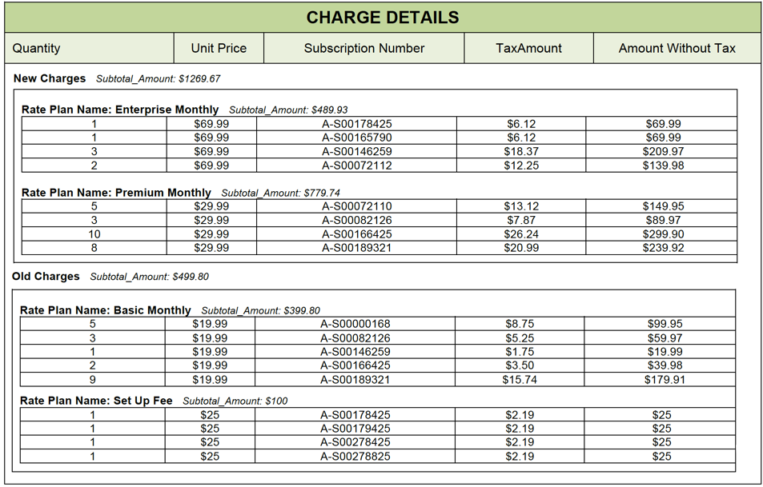
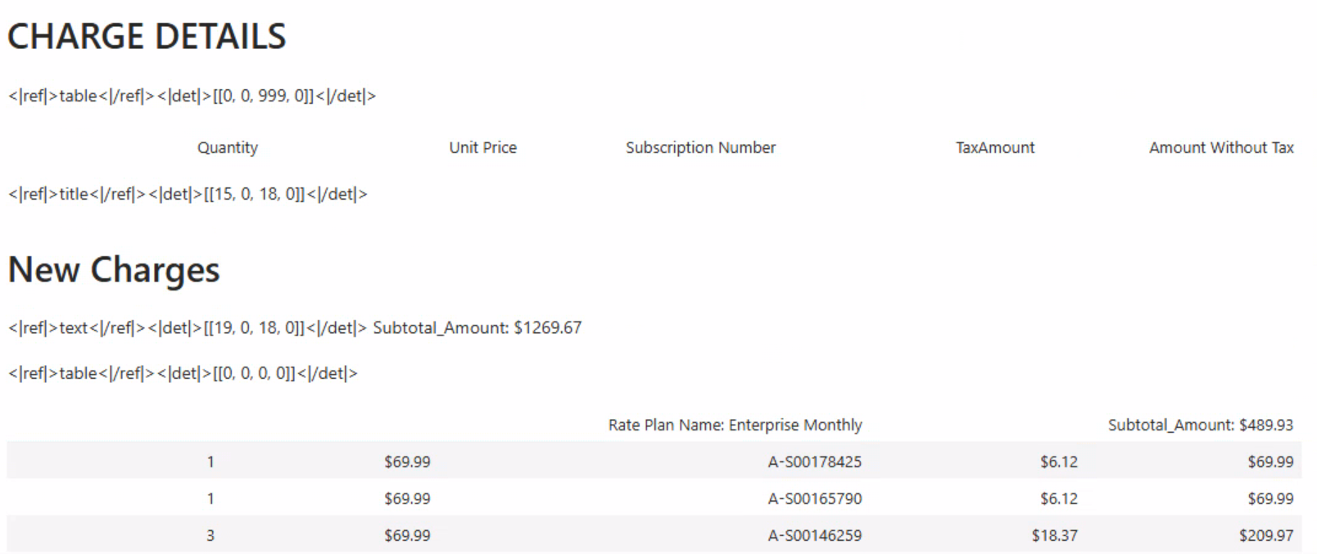
Phase 2: DeepSeek-OCR for text and table extraction
Progress: Distorted table, scanned document, and Thai language
Outlook: Nested table and hundred-cell table
DeepSeek-OCR result

Slide 8

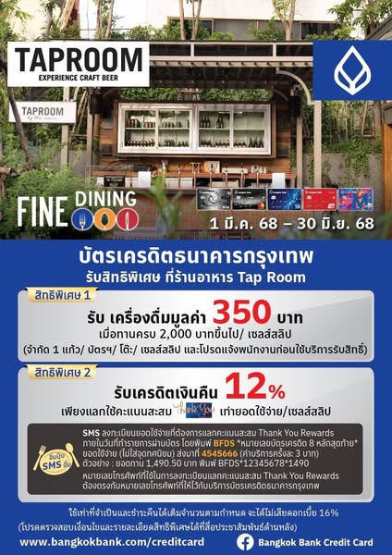
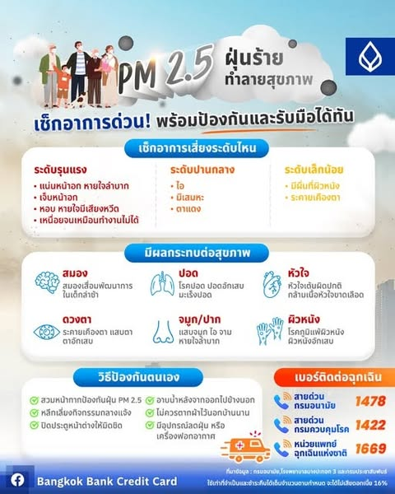

Phase 3: Bounding box (e.g., MCCS use cases)
Use case: Announcement, advertisement, and infographic
Goal: To get locations of all text and objects in an image

Slide 9
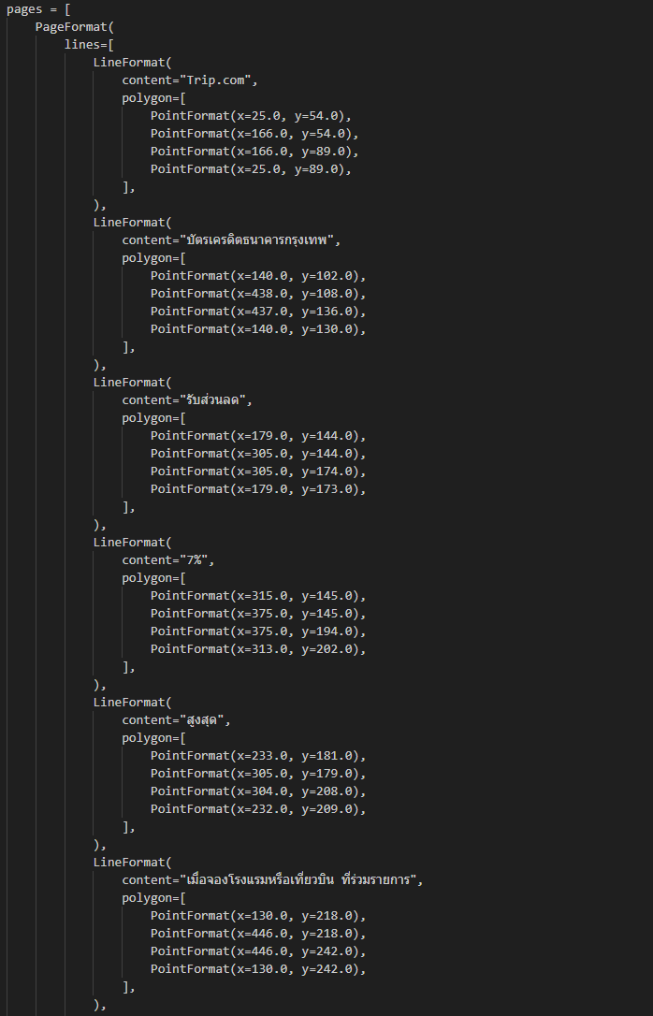
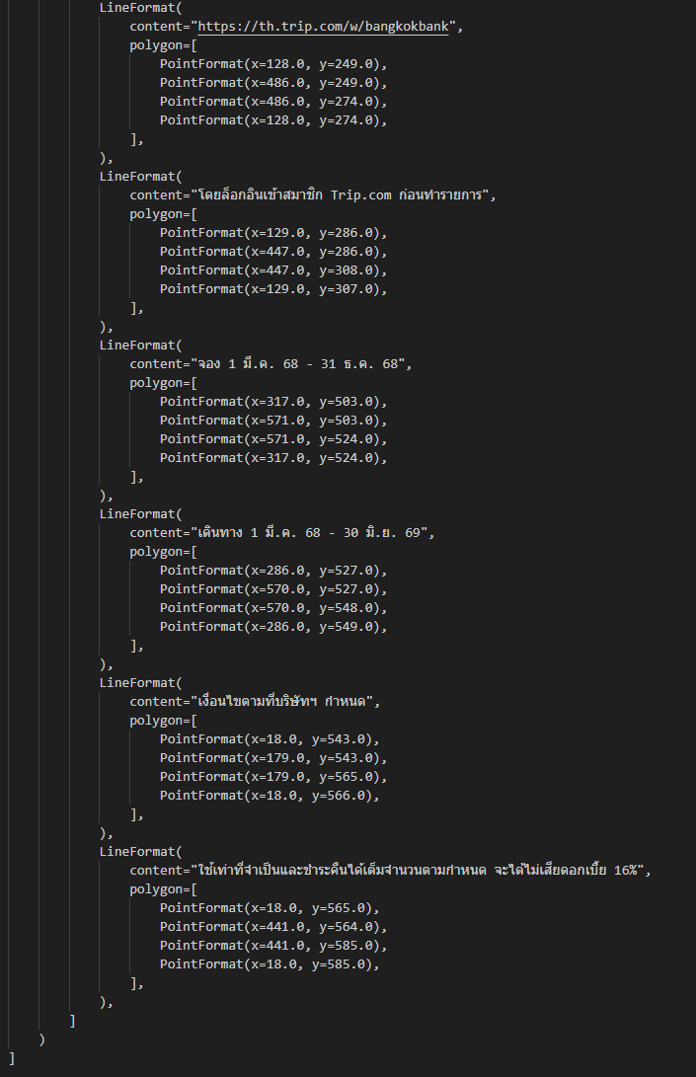
Phase 3: Bounding box (e.g., MCCS use cases)
Example: Result from Azure AI Document Intelligence
Mode: Read → Locations of all text → $1/1000 images Layout → Locations of text, tables, images → $10/1000 images
x=25, y=54
x=116, y=54
x=116, y=89
x=25, y=89

Slide 10
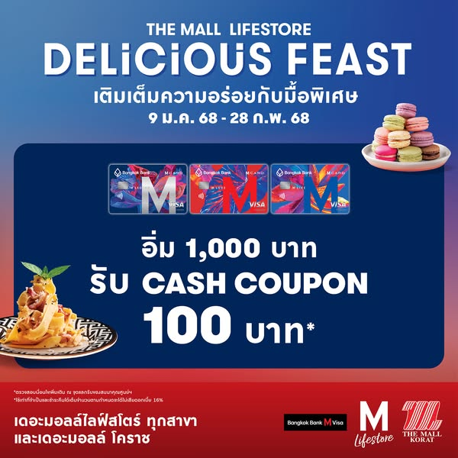
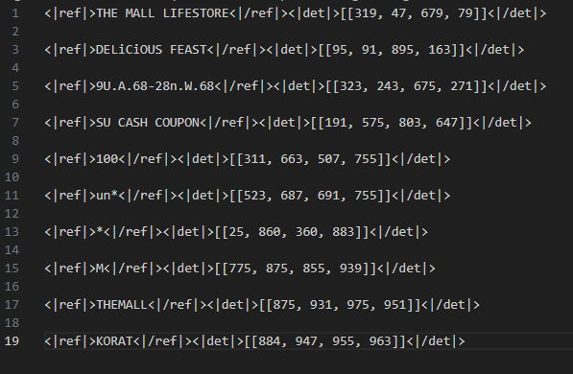
Phase 3: Bounding box (e.g., MCCS use cases)
Limitation of DeepSeek-OCR:
It cannot capture positions of all text and objects in the image
Low performance for Thai language
x=319, y=47
x=679, y=79
DeepSeek-OCR result

Slide 11
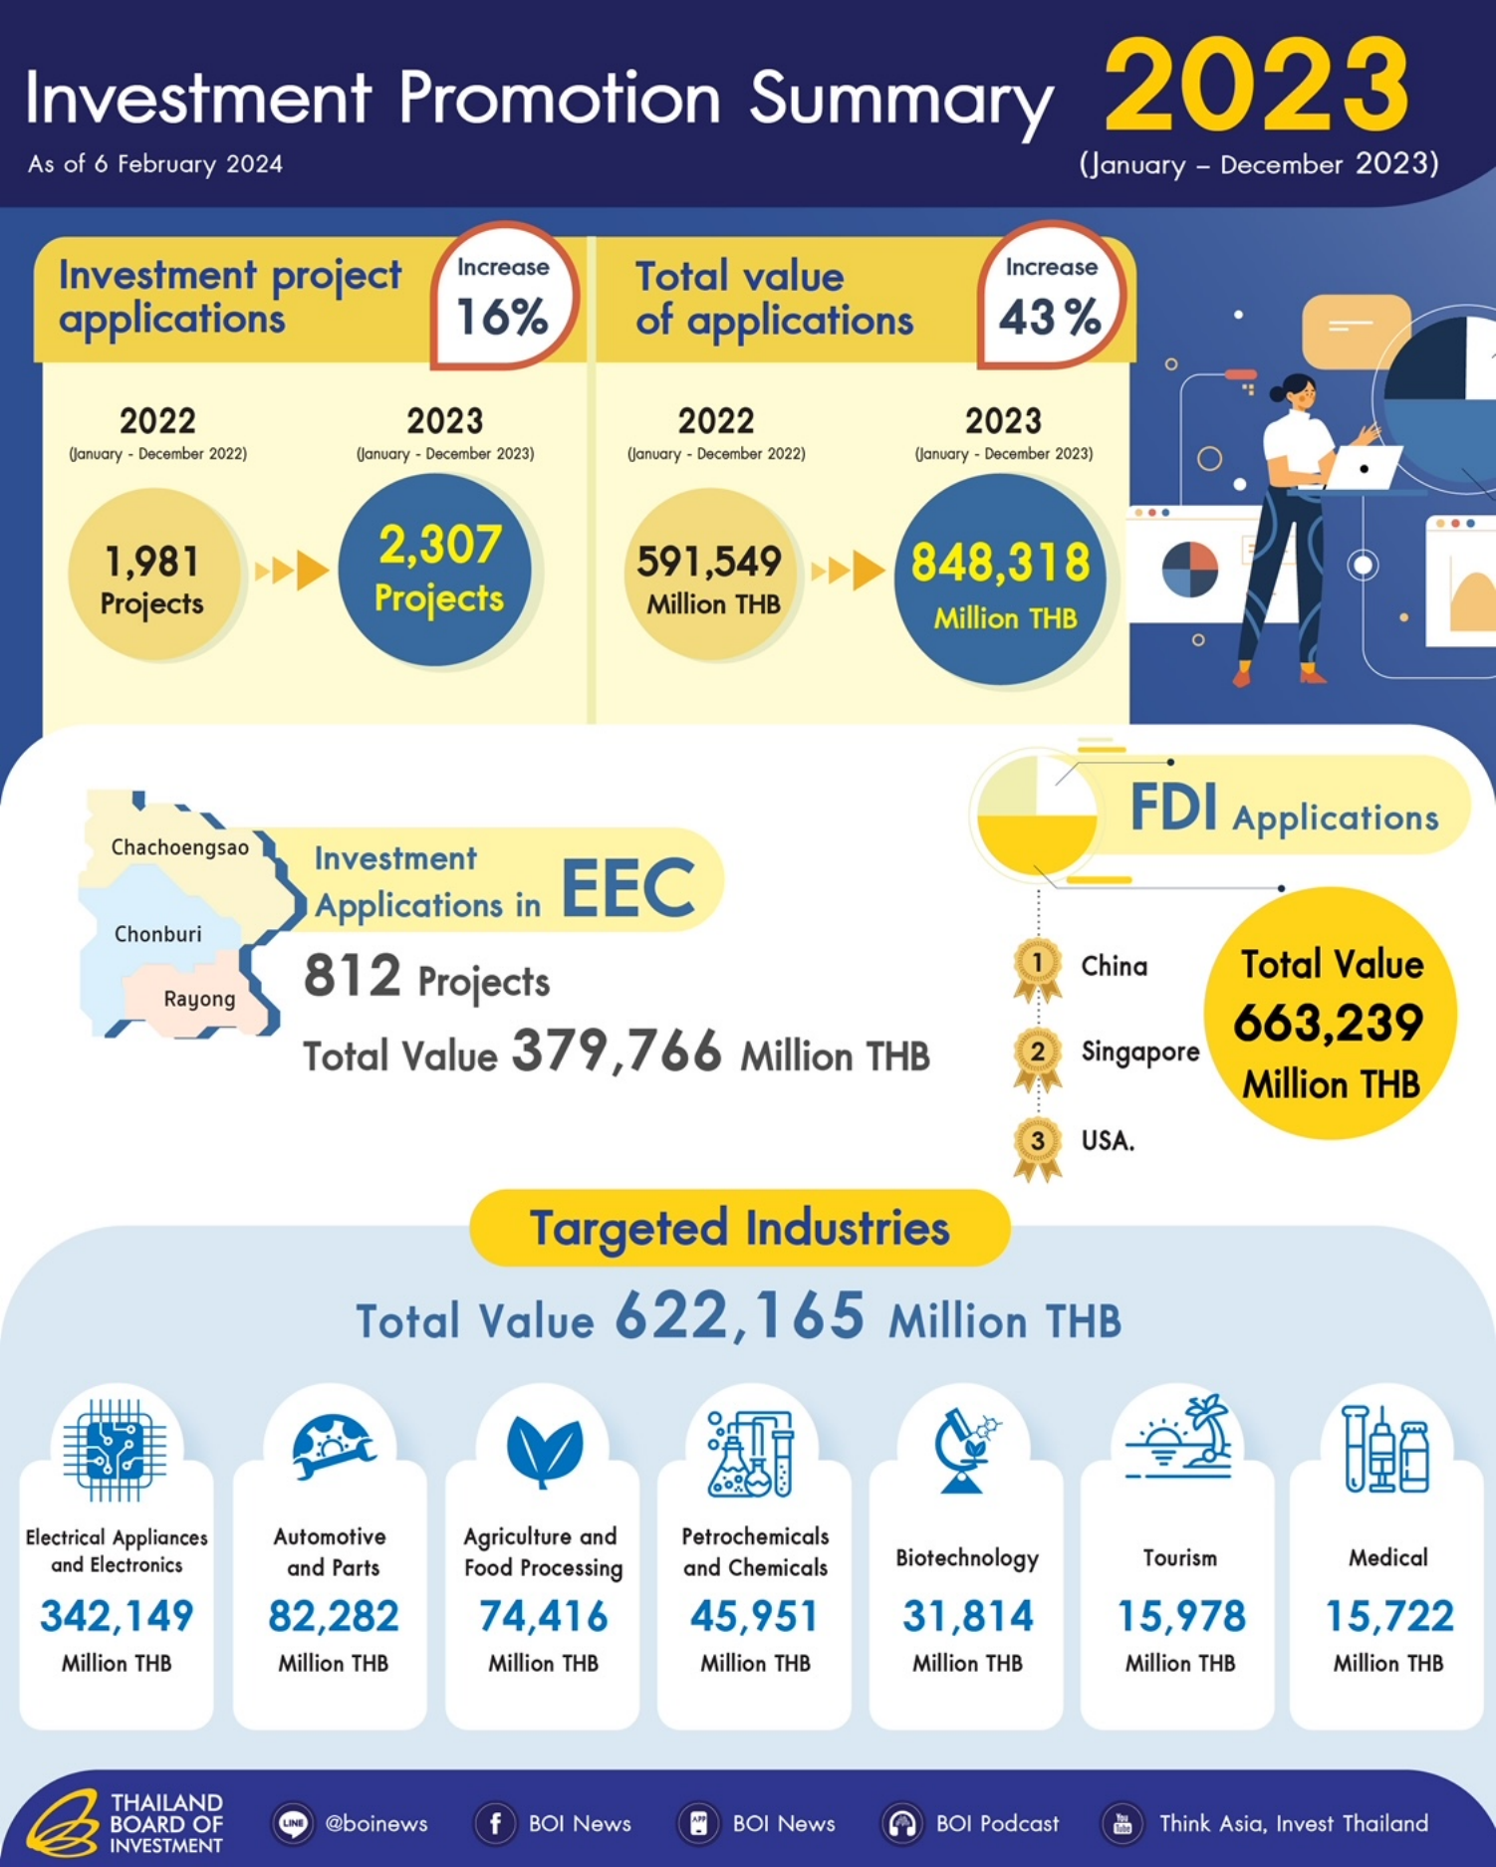
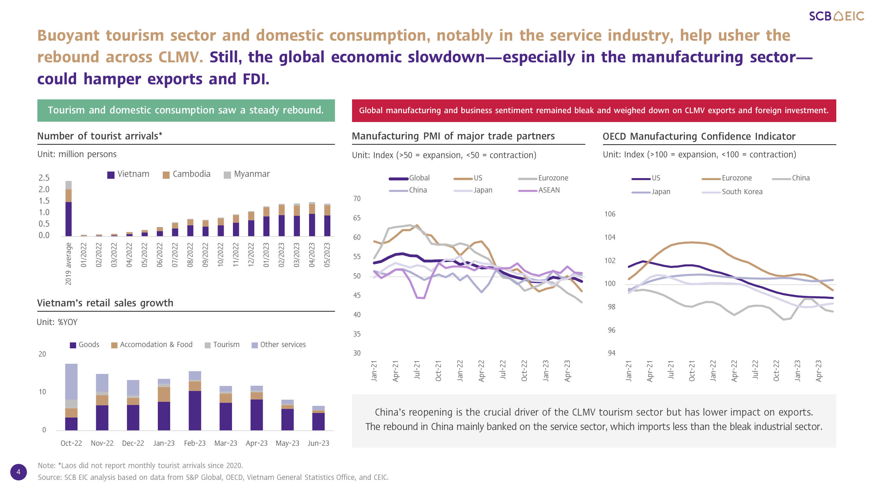
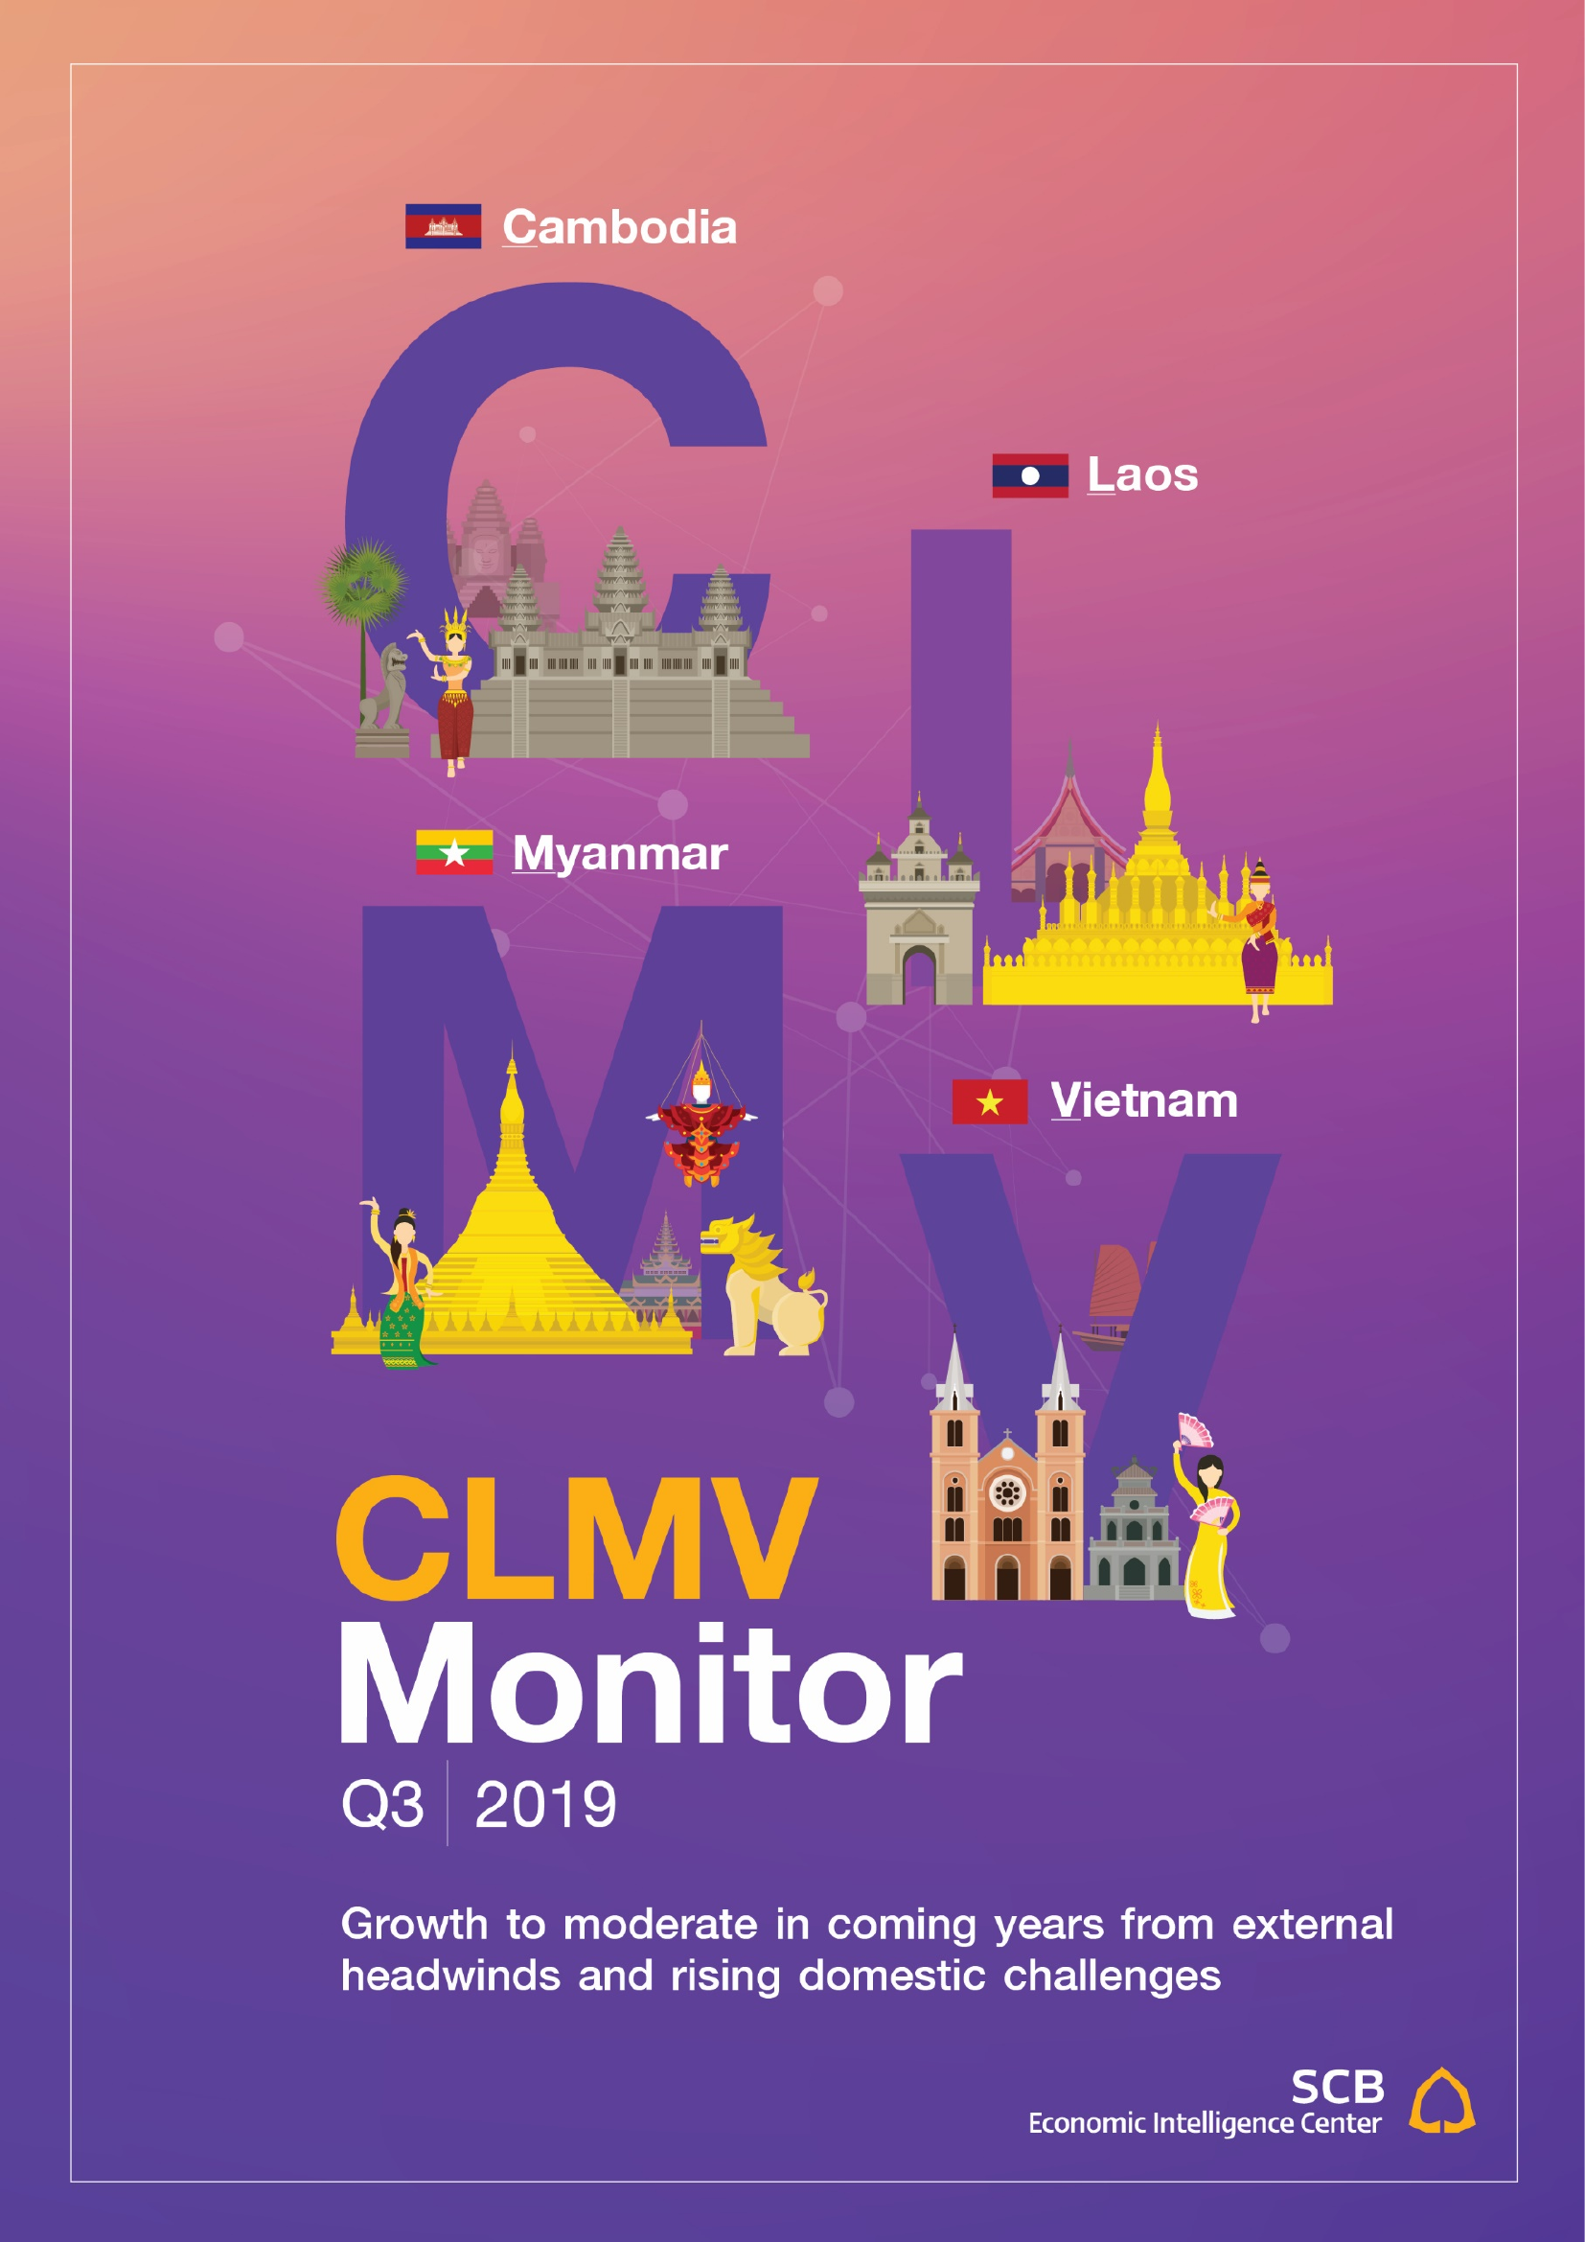
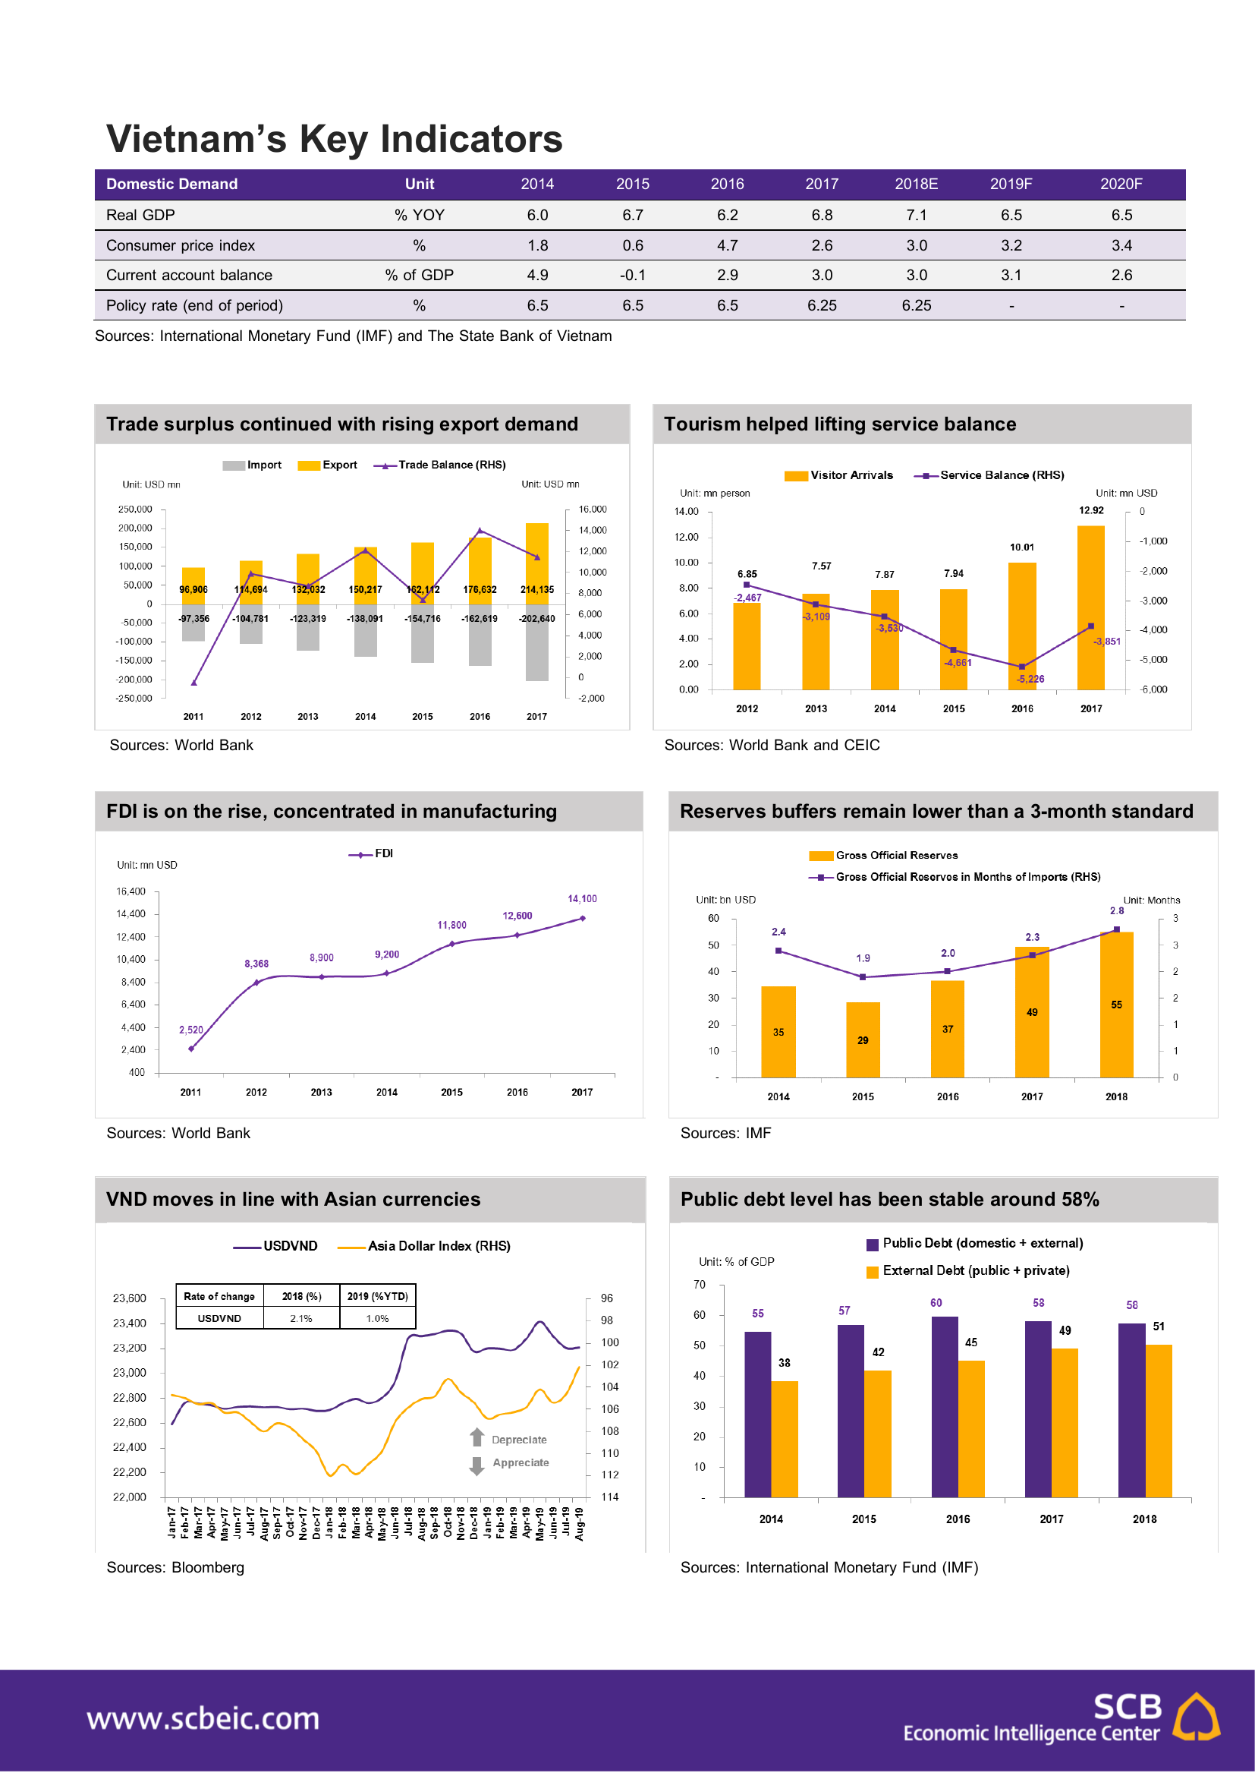
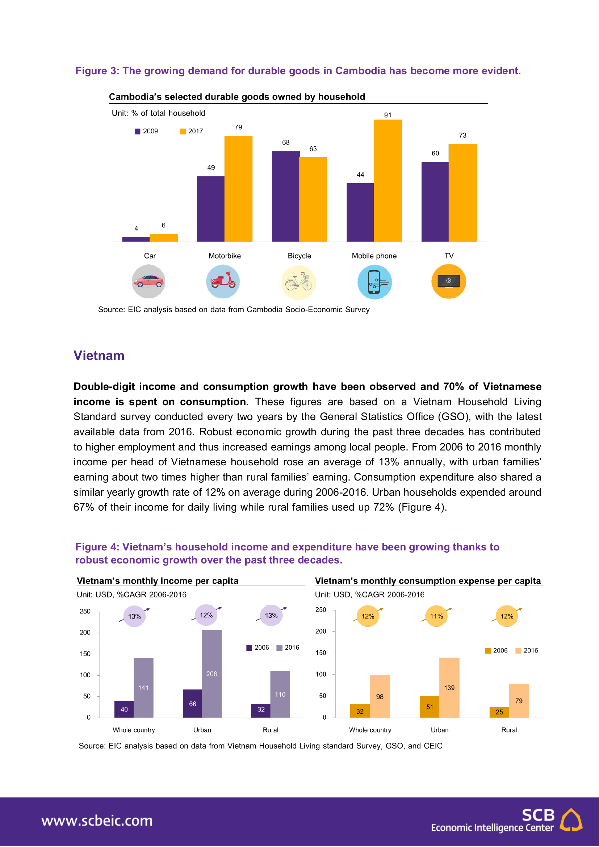
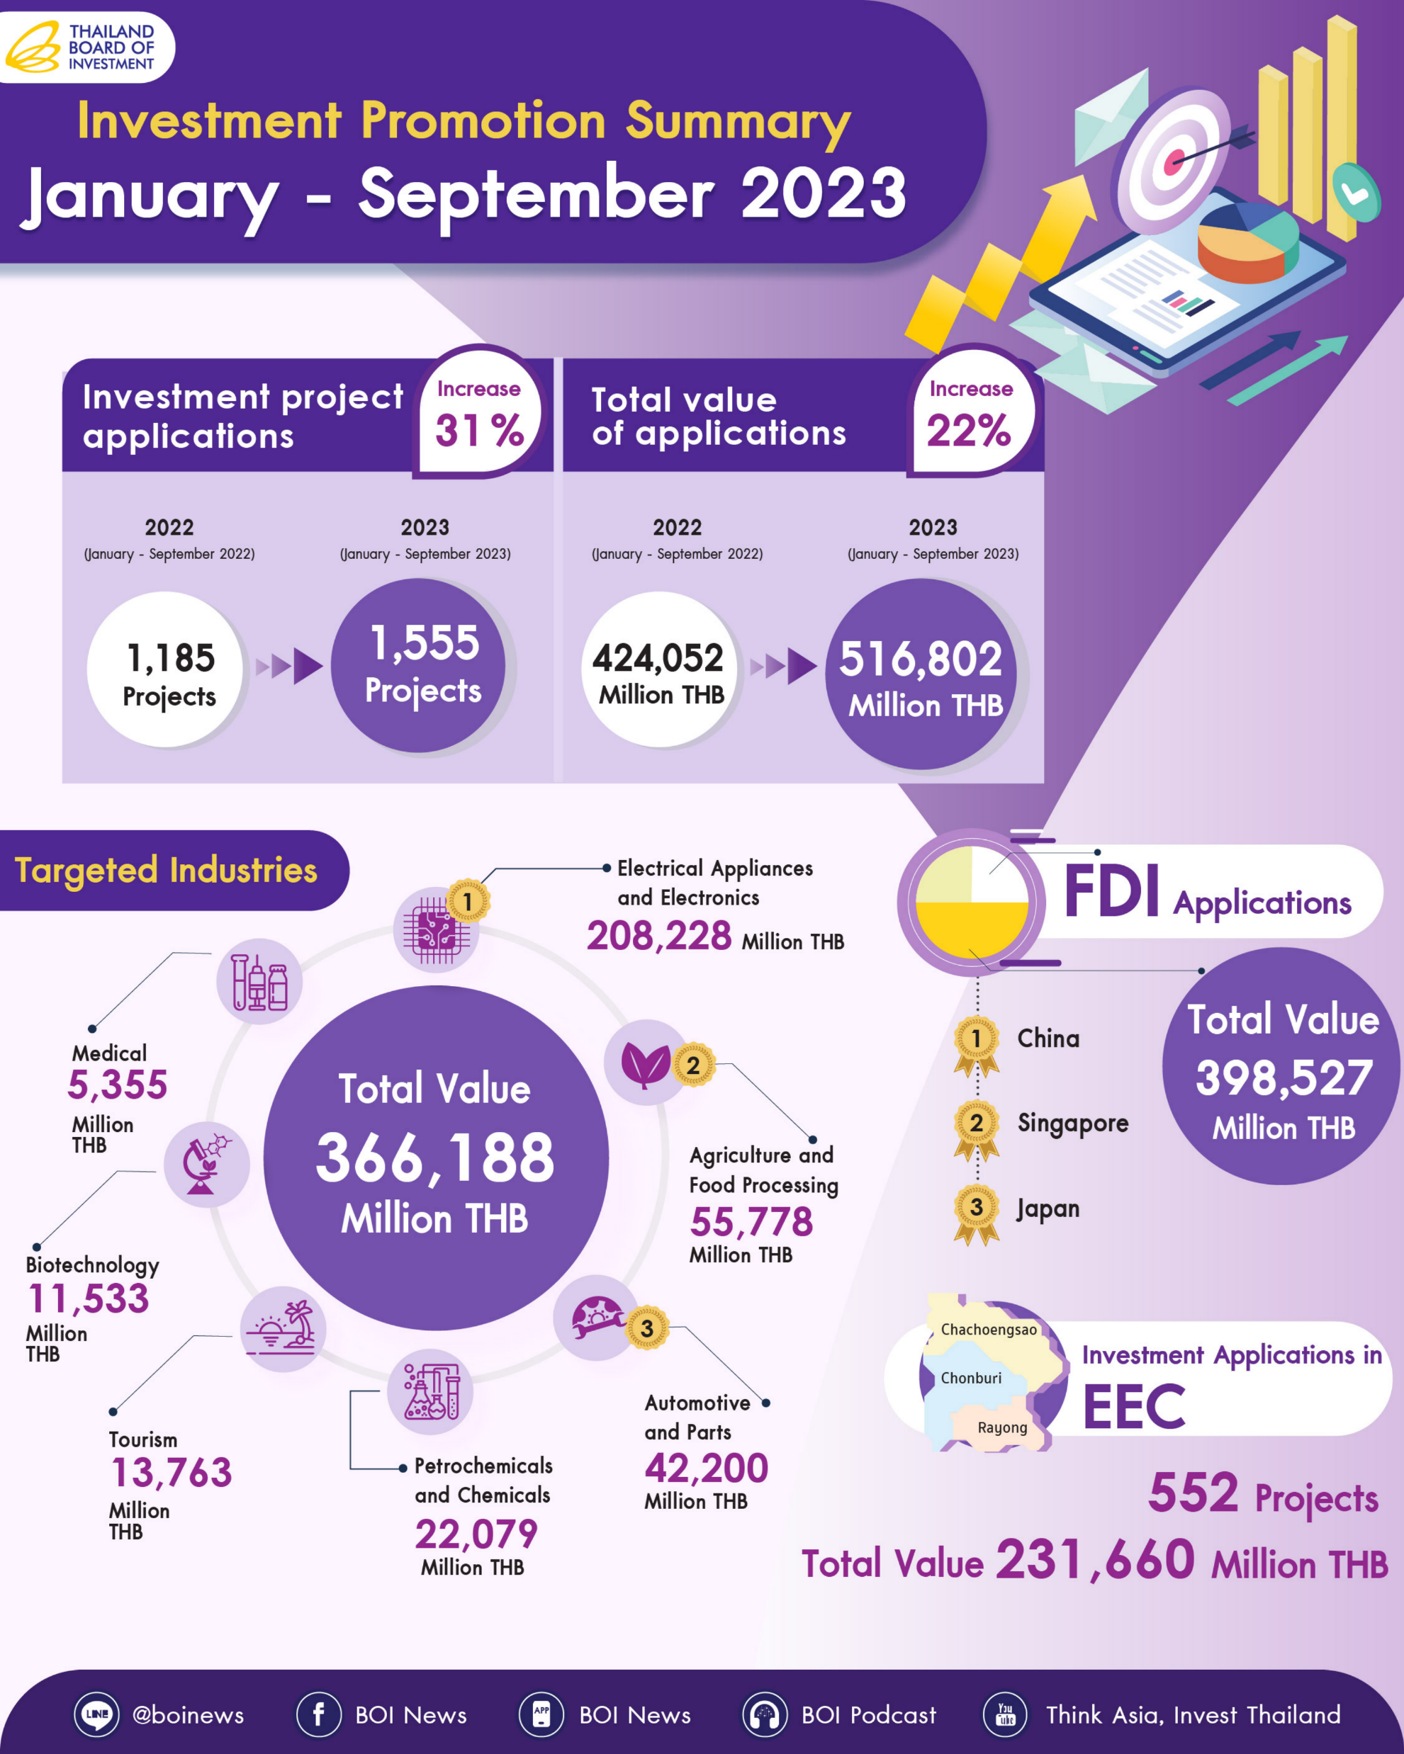
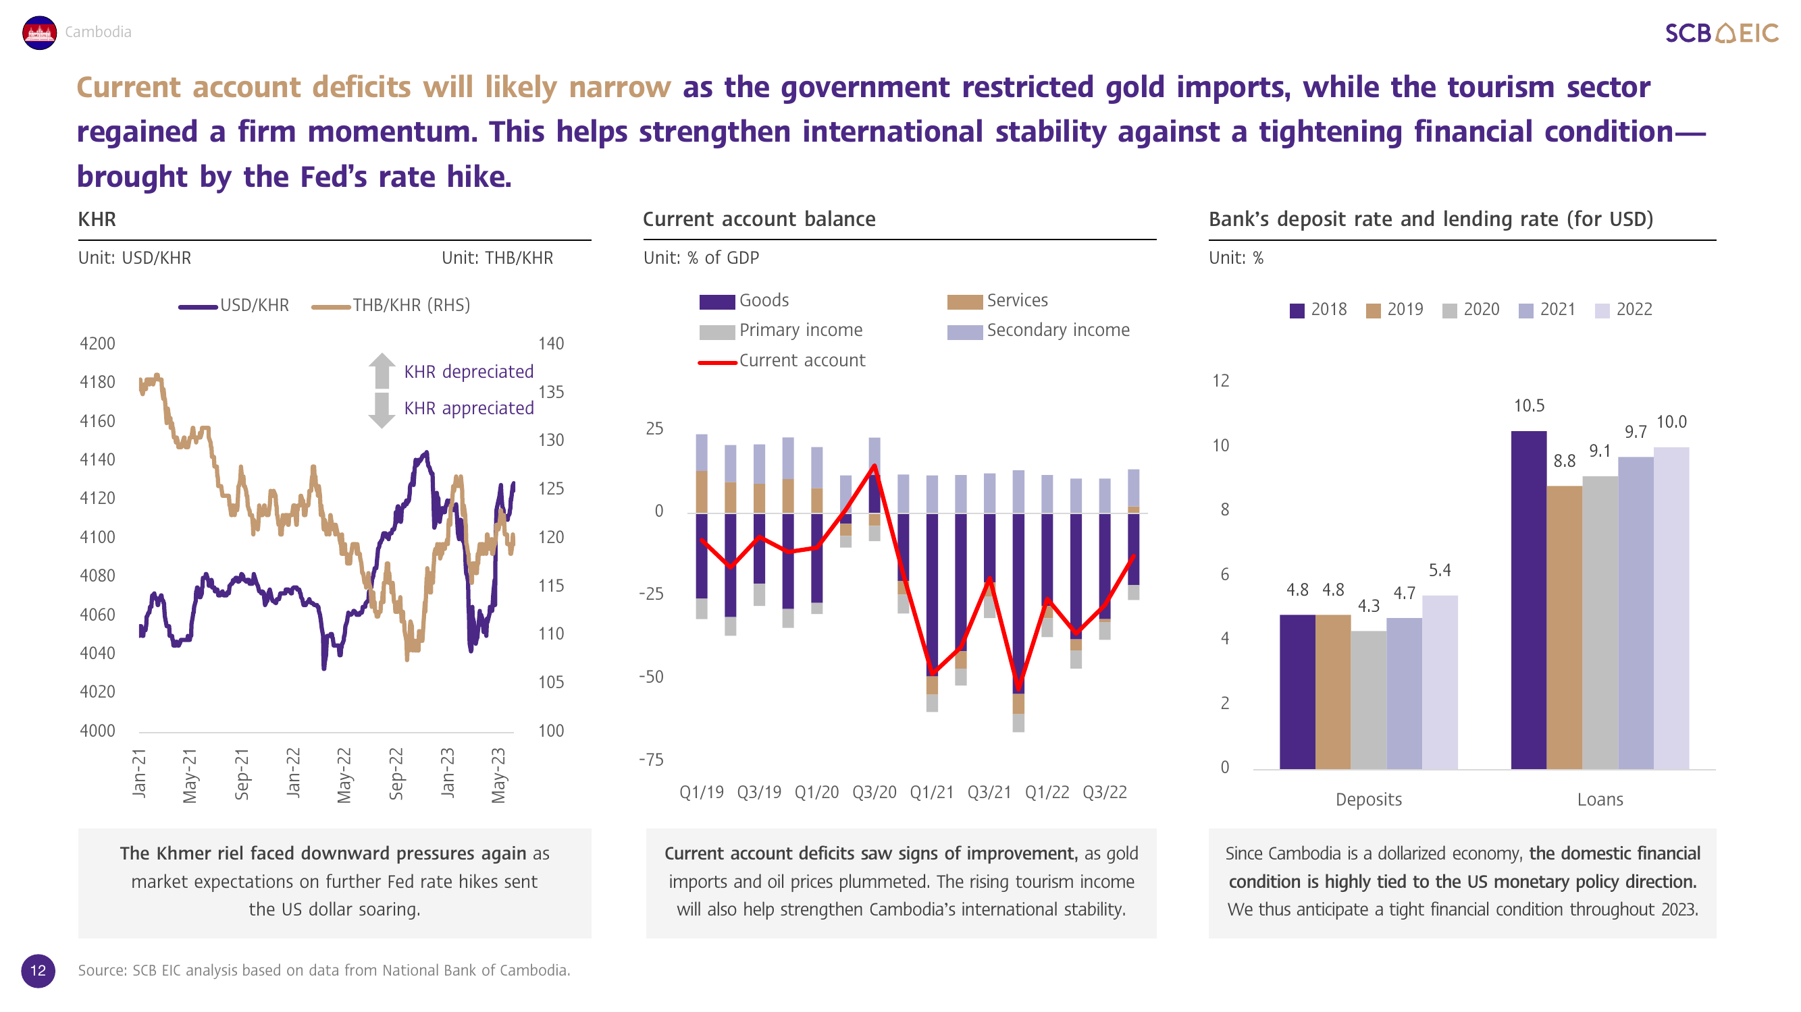
Phase 4: Image description
Use case: Documents, presentation slides, and infographics including chart, plot, and trend
Goal: To provide explanation and convert graph to HTML table

Slide 12
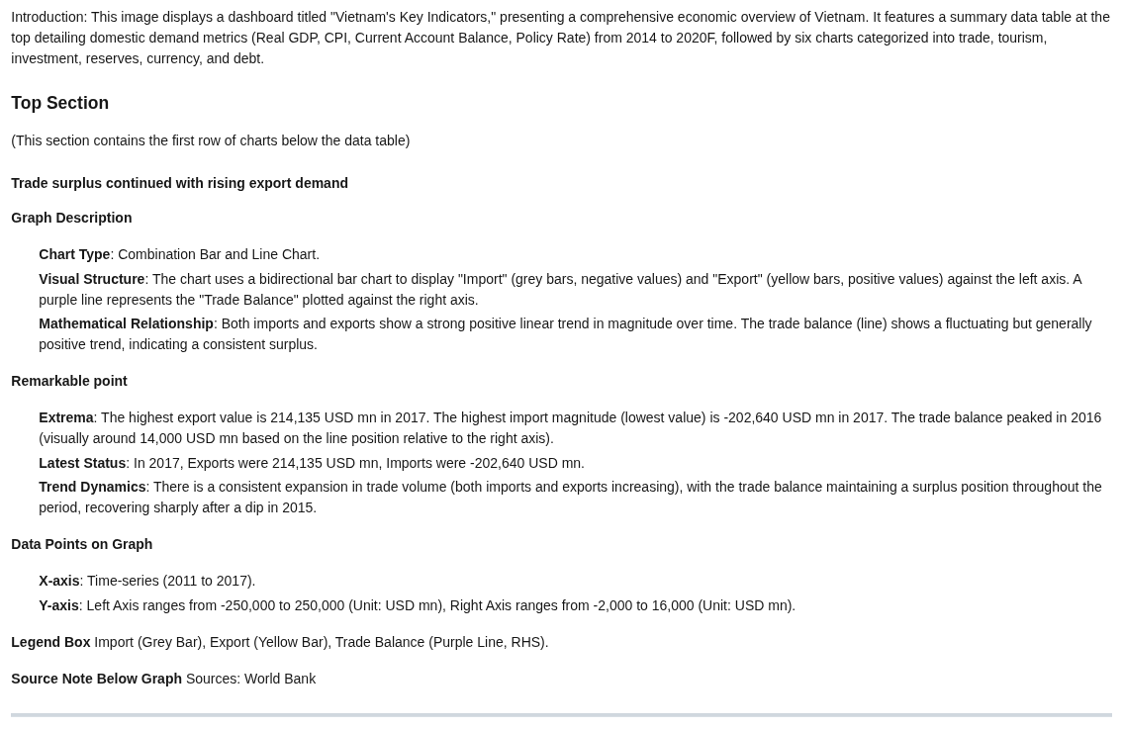
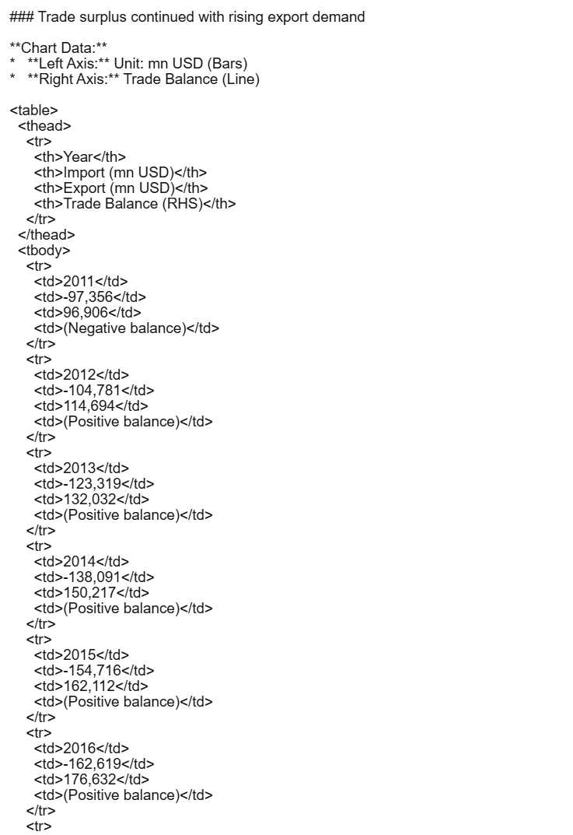
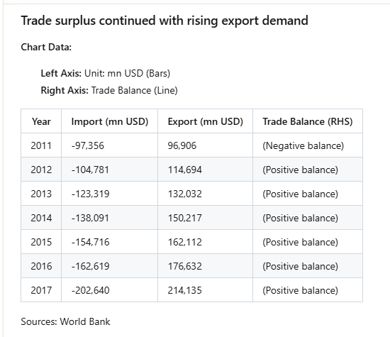
Phase 4: Image description
Example: Result from Gemini 3 Pro
Task: Description → Graph description, remarkable point, data points on graph, legend box, and source note HTML table → Convert graph to HTML table
Description
HTML table
Rendering

Slide 13
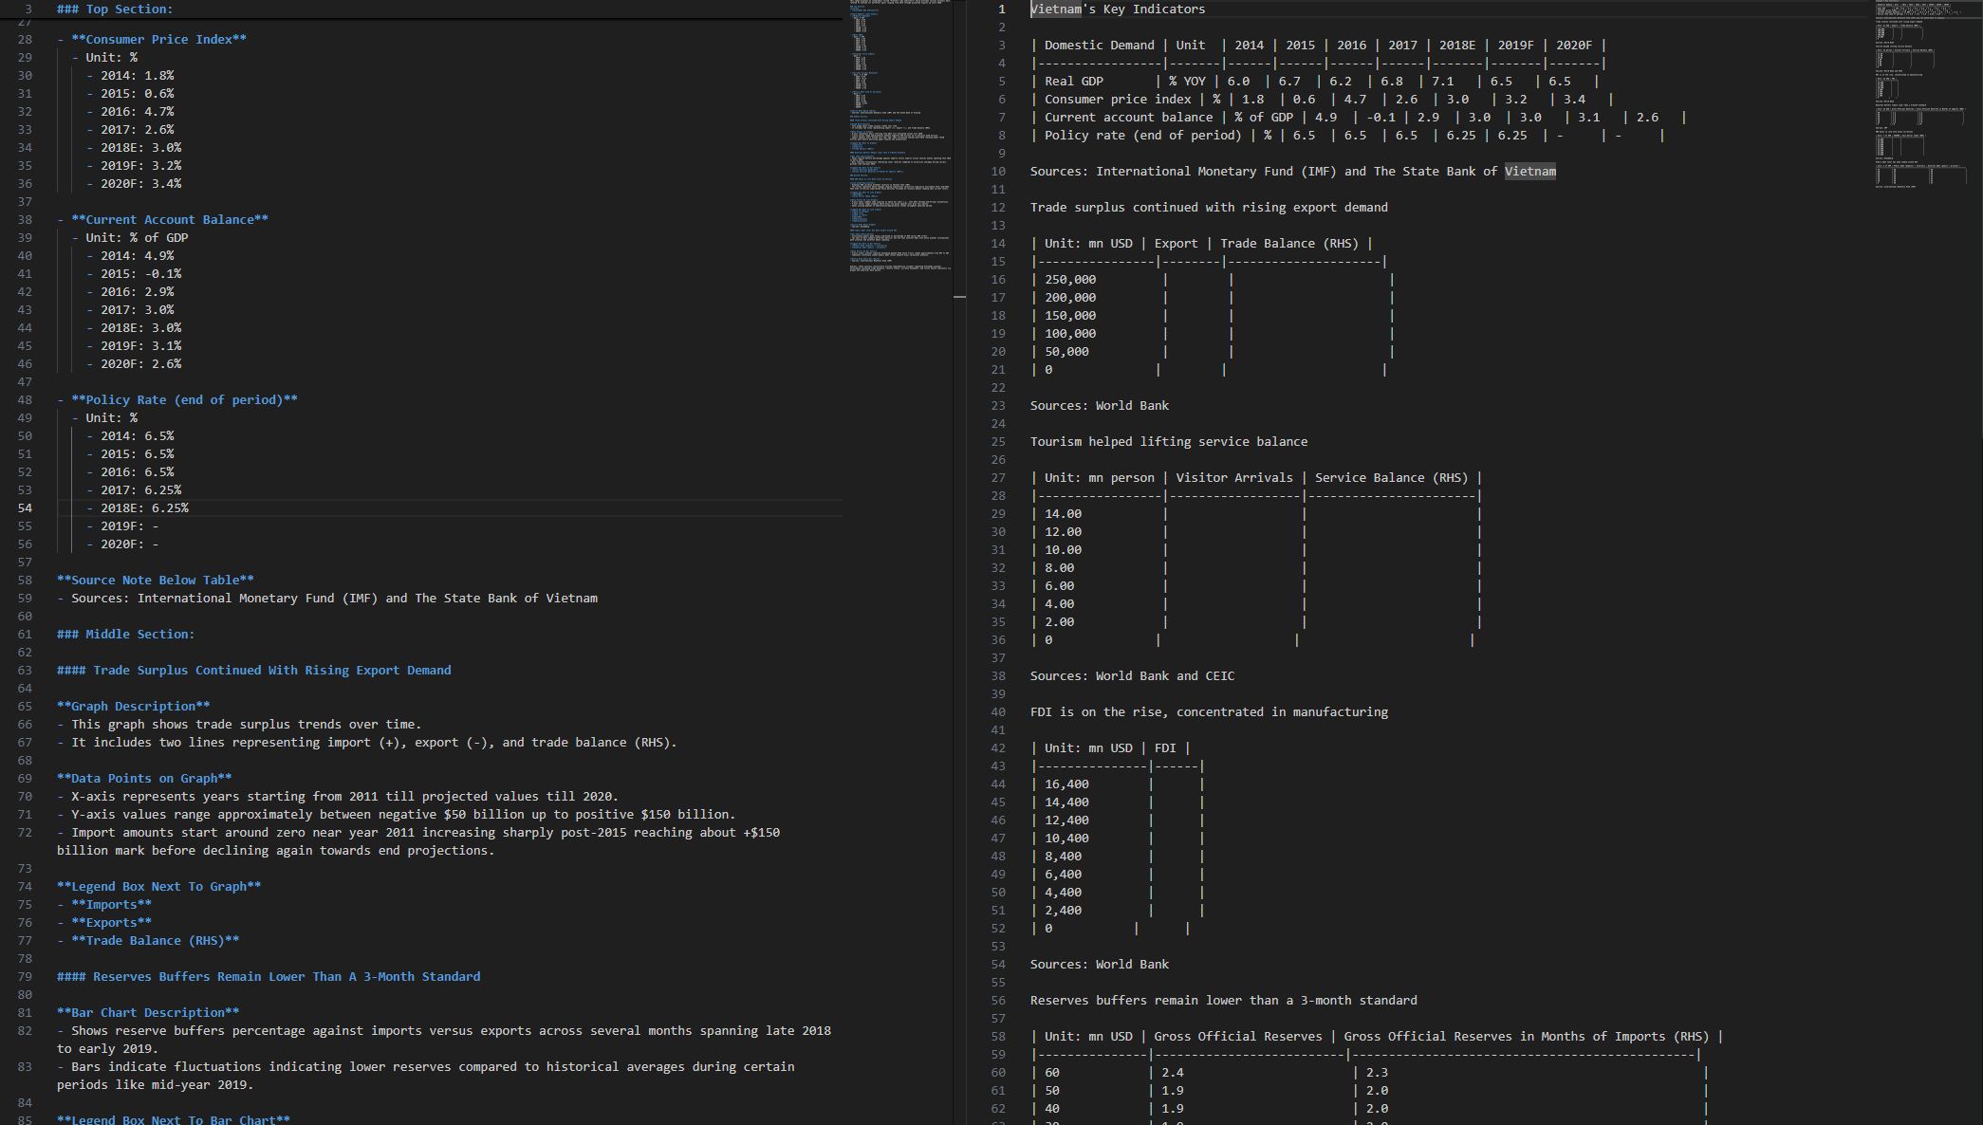
Phase 4: Image description
Limitation of DeepSeek-OCR:
For multiple charts, it cannot extract description and tables of all charts in an image.
It gives incorrect explanation and tables for complex graphs.
For converting graph to table, it takes only y-axis values and lacks other details (e.g., x-axis, data points)
Graph → Description
Graph → Table

Slide 14
OCR project
2025 | 2026
Project timeline | Sep | Oct | Nov | Dec | Jan | Feb | Mar | Apr | May
Phase 1: Qwen2.5-VL-Instruct for text and table extraction
Phase 2: DeepSeek-OCR for text and table extraction
Preparation of training dataset by using Qwen3-4B
Model training, evaluation, and testing
Phase 3: DeepSeek-OCR to locate bounding box
Preparation of training dataset by using Azure AI Document Intelligence
Model training, evaluation, and testing
Phase 4: DeepSeek-OCR for image description
Preparation of training images and automated pre-labelling
Data labelling by using human annotators
Model training, evaluation, and testing

Slide 15
Phase 4: Data labelling approach
Training dataset:
Documents and slides with chart, plot, trend = 2500 images
Infographic, announcement, and advertisement = 2000 images
General pictures = 500 images
Task:
Image description → 5000 labelled data
HTML table → 2500 labelled data
Labelling approach:
Option 1: Manual labelling → Outsourcing
Option 2: 1. Automated pre-labeling → Pre-label data using Gemini 3 Pro for image description and HTML table
2. Human verification → Validate and correct by internal labelers or outsourcing

Slide 16
Phase 4: Labelling template for chart, plot, and trend
Introduction: [Explain the overall image and its main title]
### Top / Middle / Bottom section:
#### [Graph title]
**Graph description**
**Chart type:** [e.g., line, bar, combination line & bar, donut, pie, scatter, waterfall, bubble, area]
**Visual structure:** [Describe how the data is organized, e.g., Bars represent GDP while the line represents inflation]
**Relationship:** [e.g., linear, curvilinear, exponential, logarithmic, cyclic, sigmoidal, parabola, no apparent correlation]
**Remarkable point**
**Extrema:** [Identify the highest value and lowest value with their specific dates/categories]
**Latest Status:** [Explicitly state the value of the *most recent* data point shown]
**Trend Dynamics:** [e.g., "upward trend with high volatility," "sharp V-shaped recovery," "plateauing after a surge"]
**Data points on graph**
**X-axis:** [Identify the domain, e.g., time-series (start year to end year), categorical (list the main categories)]
**Y-axis:** [Identify the range and units, e.g., Left axis…, Right axis…]
**Legend box** [Distinguish between the different categories]
**Source note below graph** [If applicable]
Summary: [Provide summary of the main insight derived from this entire image]

Slide 17
Phase 4: Labelling template for infographic, announcement, and advertisement
Introduction: [Explain the overall image type and its main purpose]
### Top banner / Central body / Bottom footer
**Actual header found in this section:**
- Details: [Extract the content in detail. Include specific numbers, prices, dates, rules, or percentages. If there are bullet points, list them]
**Actual header found in this section:**
- Details: [Extract the content in detail. For ads, include specific conditions like "limit 1 glass/card/table.]
Summary: [Provide summary of the main message, insight, or primary call-to-action of this image]

Slide 18
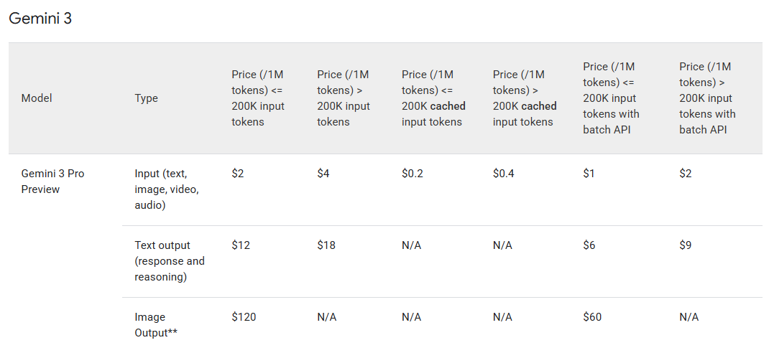
Phase 4: Inference cost of Gemini 3 Pro
50% Discount
Send a request via the Batch API
The system processes them whenever it has free capacity.
guarantee the job will be done within 24 hours
Batch API allows you to submit millions of requests at once without hitting "Too Many Requests" errors.
Cost of input image
Token count for images depends on “media_resolution”.
High (Default): 1,120 tokens = $0.00112
Best for: Charts, small text, and detailed diagrams.
Medium: 560 tokens = $0.00056
Best for: Standard document pages or large text.
Low: 280 tokens = $0.00028
Best for: General scene description (not recommended for reading charts).
Input image

Slide 19
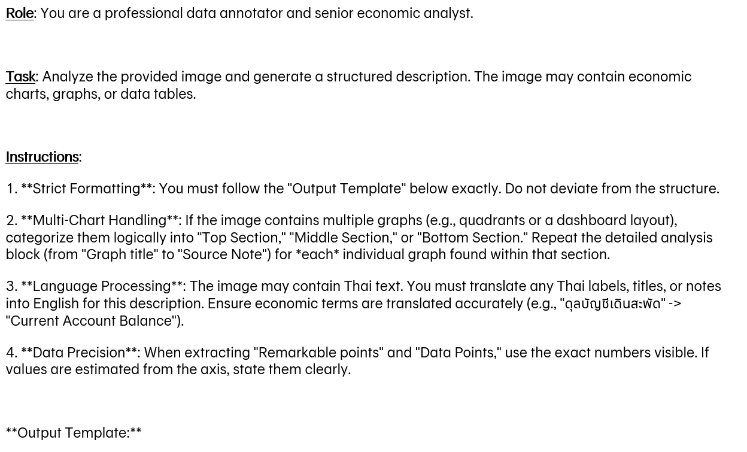
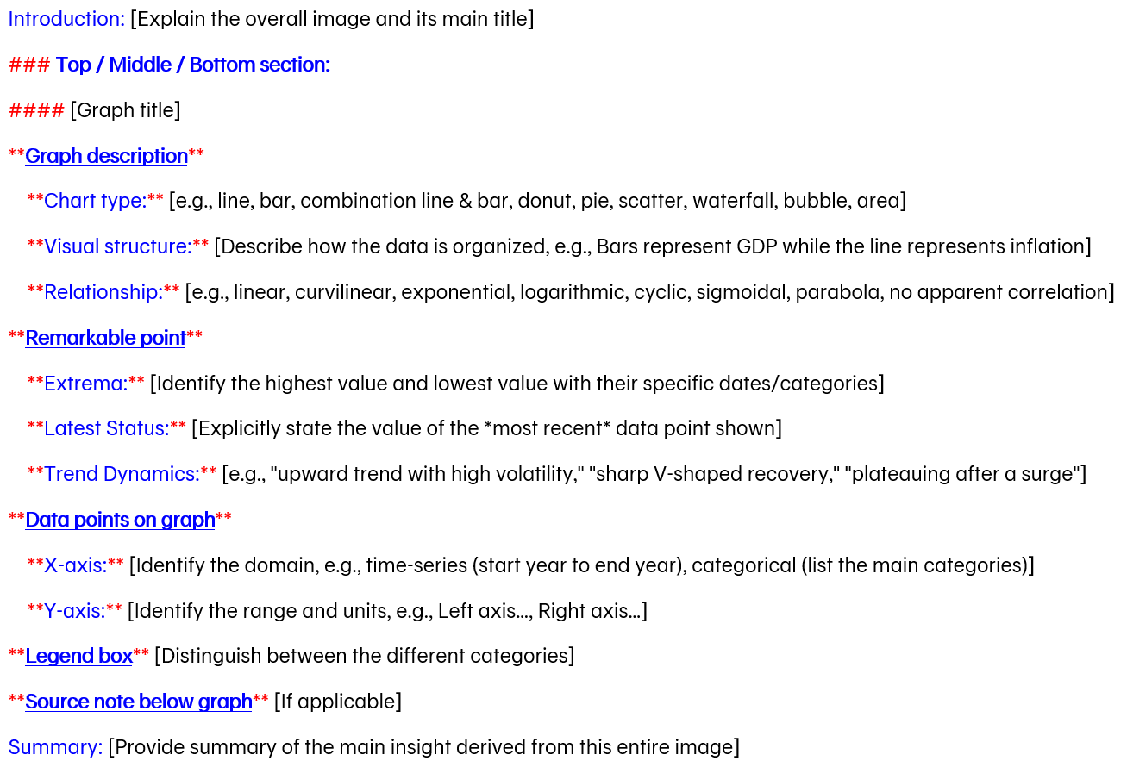
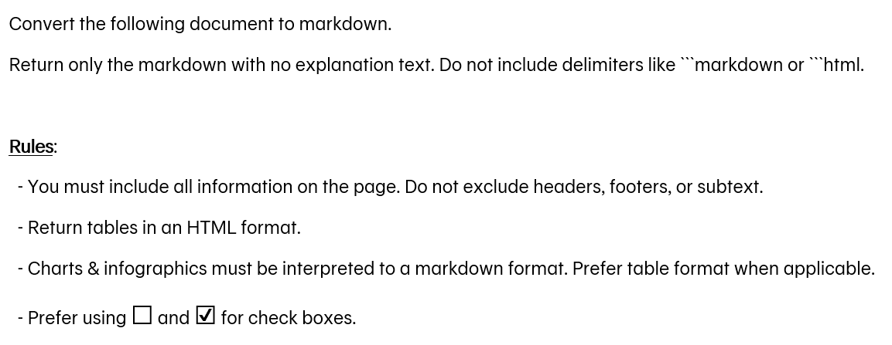
Phase 4: Inference cost of Gemini 3 Pro
50% Discount
Send a request via the Batch API
The system processes them whenever it has free capacity.
guarantee the job will be done within 24 hours
Batch API allows you to submit millions of requests at once without hitting "Too Many Requests" errors.
Prompt cost for image description
~1000 tokens = $0.001
Prompt cost for HTML table
~200 tokens = $0.0002

Slide 20
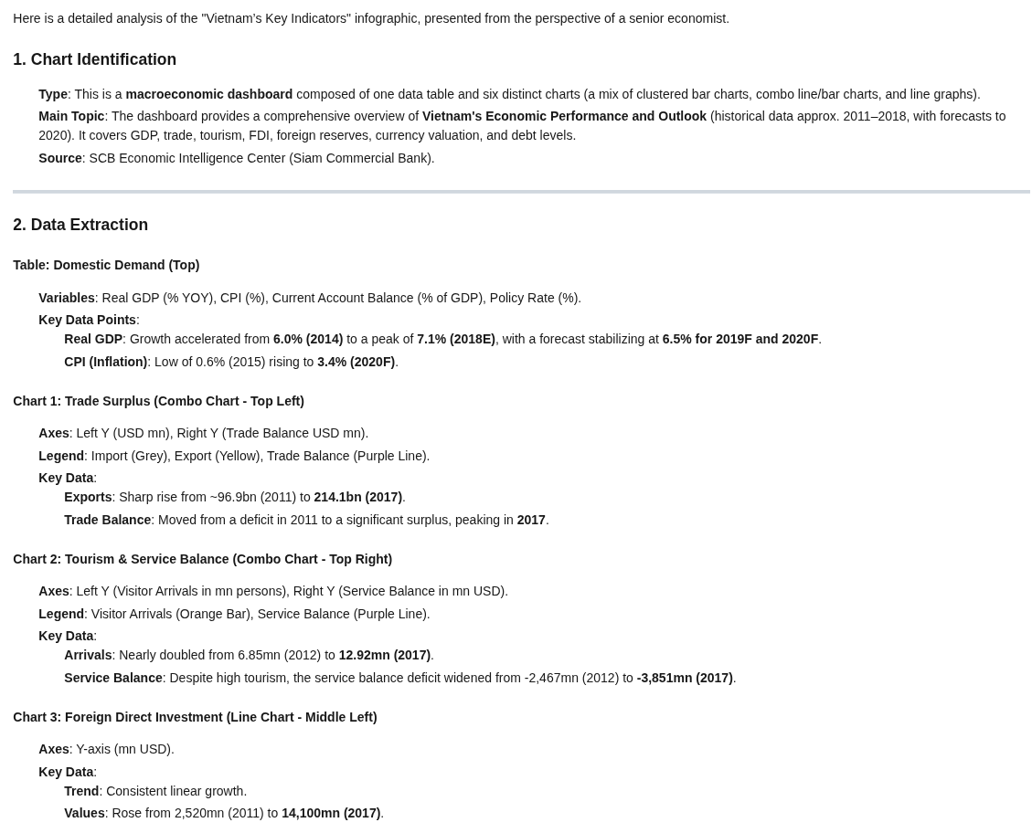
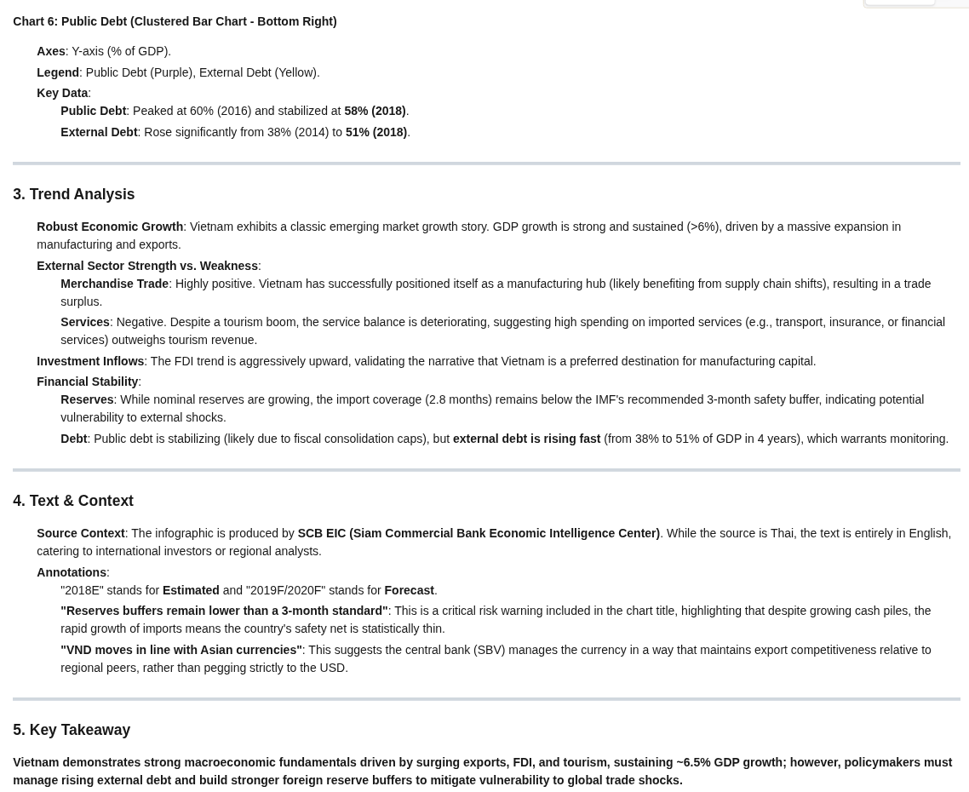
Phase 4: Inference cost of Gemini 3 Pro
50% Discount
Send a request via the Batch API
The system processes them whenever it has free capacity.
guarantee the job will be done within 24 hours
Batch API allows you to submit millions of requests at once without hitting "Too Many Requests" errors.
Output description
Output cost
The output contains graph and image explanation.
Estimated token count: ~2114 tokens
Output price: $6.00 per 1 million tokens.
Calculation: $(2114 / 1,000,000) * $6.00
Output cost: $0.0127

Slide 21
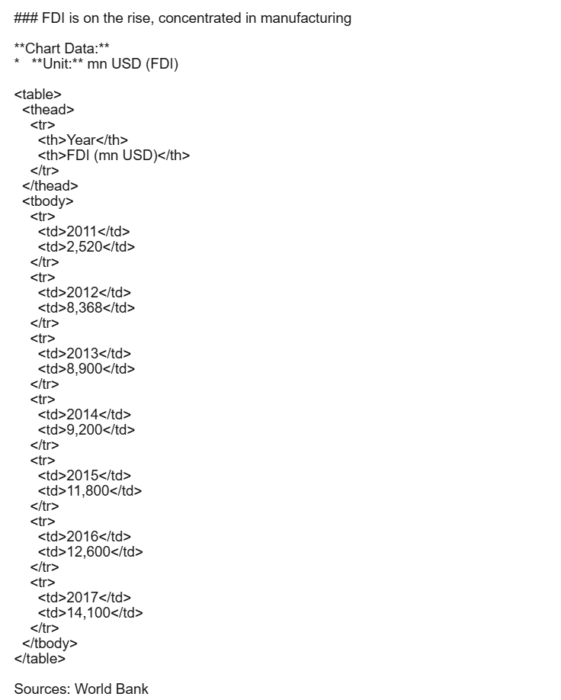
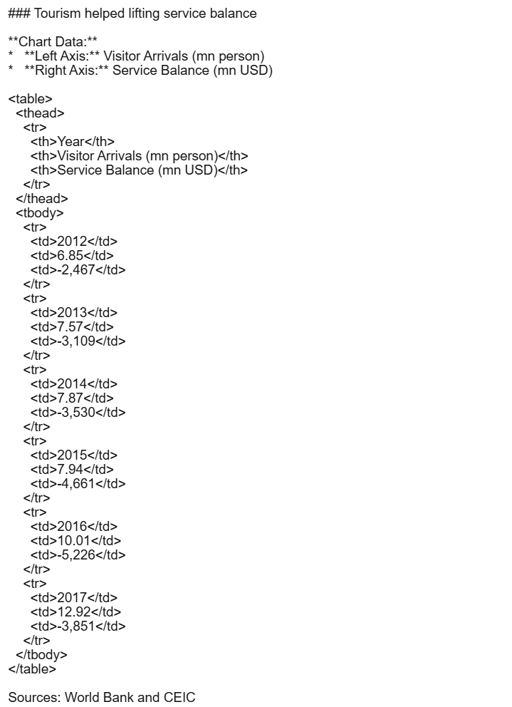
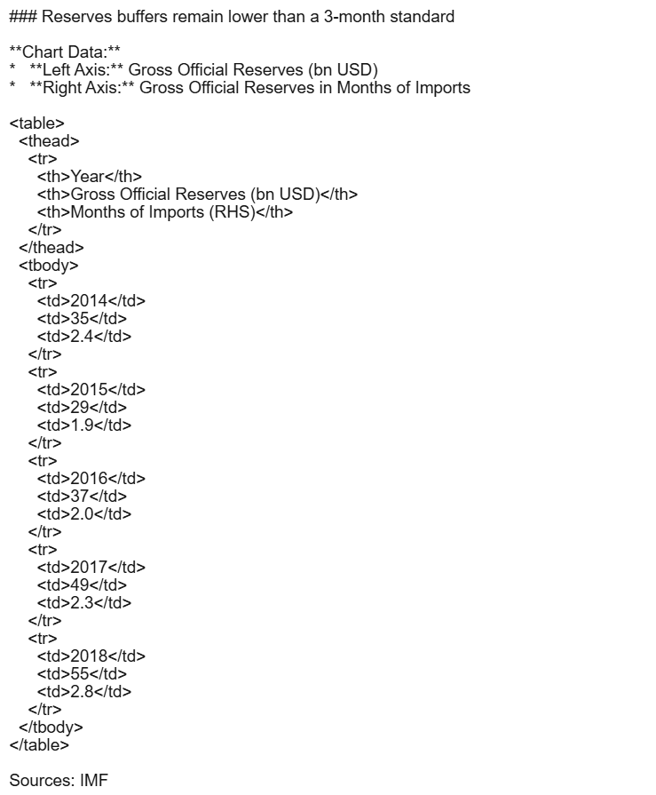
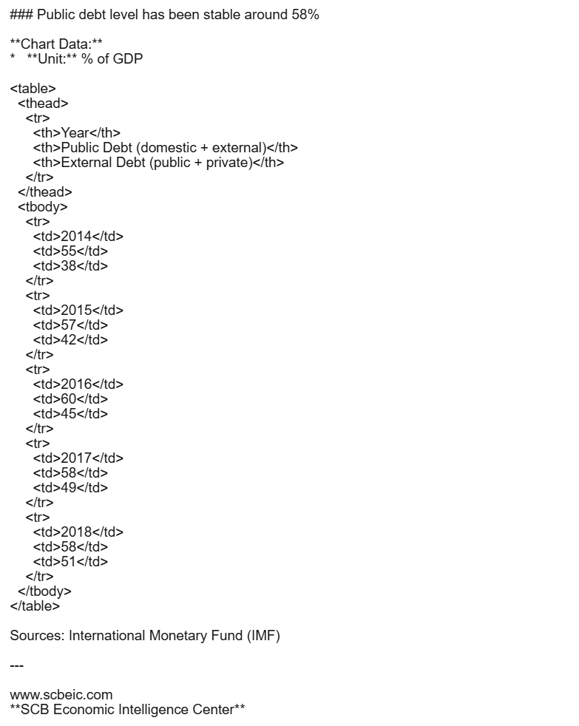
Phase 4: Inference cost of Gemini 3 Pro
50% Discount
Send a request via the Batch API
The system processes them whenever it has free capacity.
guarantee the job will be done within 24 hours
Batch API allows you to submit millions of requests at once without hitting "Too Many Requests" errors.
Output table
Output cost
The output contains formatted tables and HTML.
Estimated token count: ~1100 tokens
Output price: $6.00 per 1 million tokens.
Calculation: $(1100 / 1,000,000) * $6.00
Output cost: $0.0066

Slide 22
Phase 4: Inference cost of Gemini 3 Pro
Total cost for image description
Input image: $0.00112
Prompt: $0.001
Output: $0.0127
Total cost: $0.0148 = ฿0.46
Total cost for HTML table
Input image: $0.00112
Prompt: $0.0002
Output: $0.0066
Total cost: $0.00792 = ฿0.25
Labelling approach:
Option 1: Manual labelling → Outsourcing
Option 2: 1. Automated pre-labeling → Pre-label data using Gemini 3 Pro for image description and HTML table
2. Human verification → Validate and correct by internal labelers or outsourcing
5000 images*฿0.46
= ฿2300
2500 images*฿0.25
= ฿625

Slide 23
Phase 4: Outsourcing for data labelling
Thai AI Data Services
ZTRUS (Accomate Co., Ltd.) → www.ztrus.com, contact@ztrus.com
AI GEN (AI GEN Co., Ltd.) → www.aigencorp.com, contact@aigencorp.com
Wang Data Market (by Wang) → www.wang.in.th (a Thai platform specifically for crowdsourcing data labeling)
2. Global Providers with Thai Support
Kotwel → www.kotwel.com, contact@kotwel.com
Lionbridge (Thailand) → www.lionbridge.com,

Slide 24
Back-up Slides

Slide 25
Why DeepSeek-OCR?
Capabilities: Not just reads text, DeepSeek understands layouts, allowing to extract complex financial tables, visualize trends from charts, and pinpoint data sources with bounding boxes.
Memory save & fast inference: DeepSeek-OCR uses a unique architecture that compresses visual information (images) into few tokens (up to 10x compression).
Open-weight model: DeepSeek-OCR can be deployed on-premise or in a private cloud (VLLM).
Unified workflow: One Model, Many Tasks. DeepSeek can handle OCR, chart analysis, and object detection
Multilingual Support: DeepSeek has strong performance in multilingual contexts (including Asian languages)
Data privacy: As an on-premise model, this ensures sensitive business data (financial reports, PII) never leaves the secure infrastructure, satisfying compliance requirements.

Slide 26
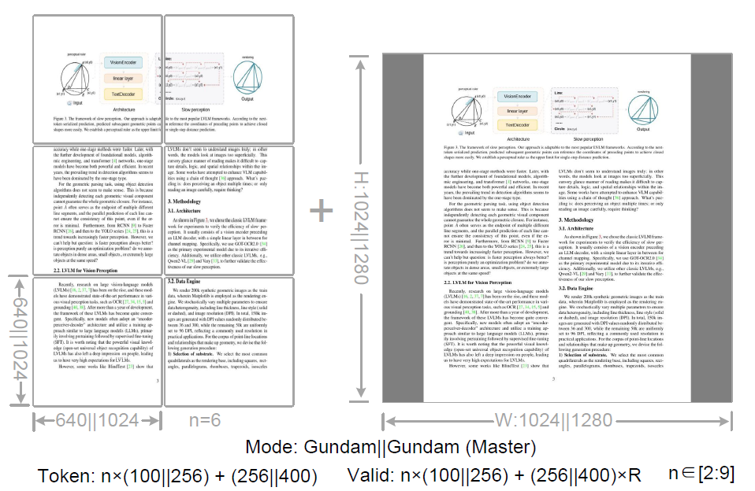
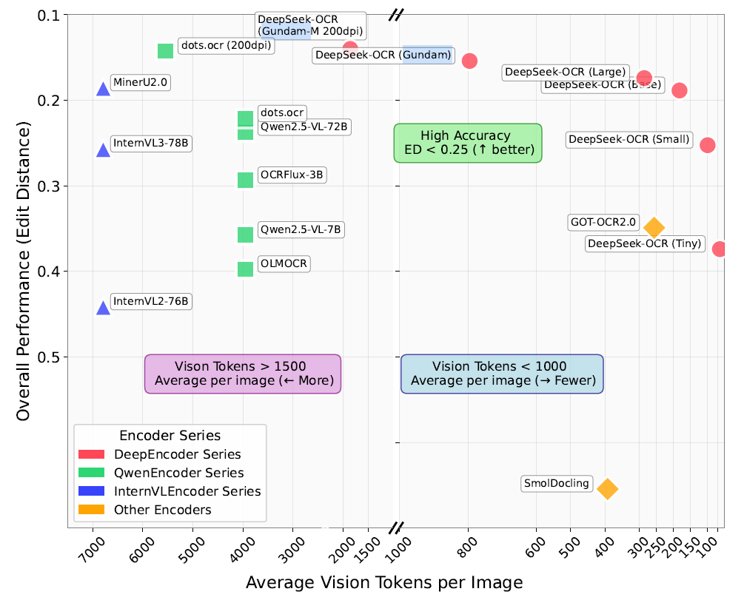
Resolution mode in DeepSeek-OCR

Slide 27
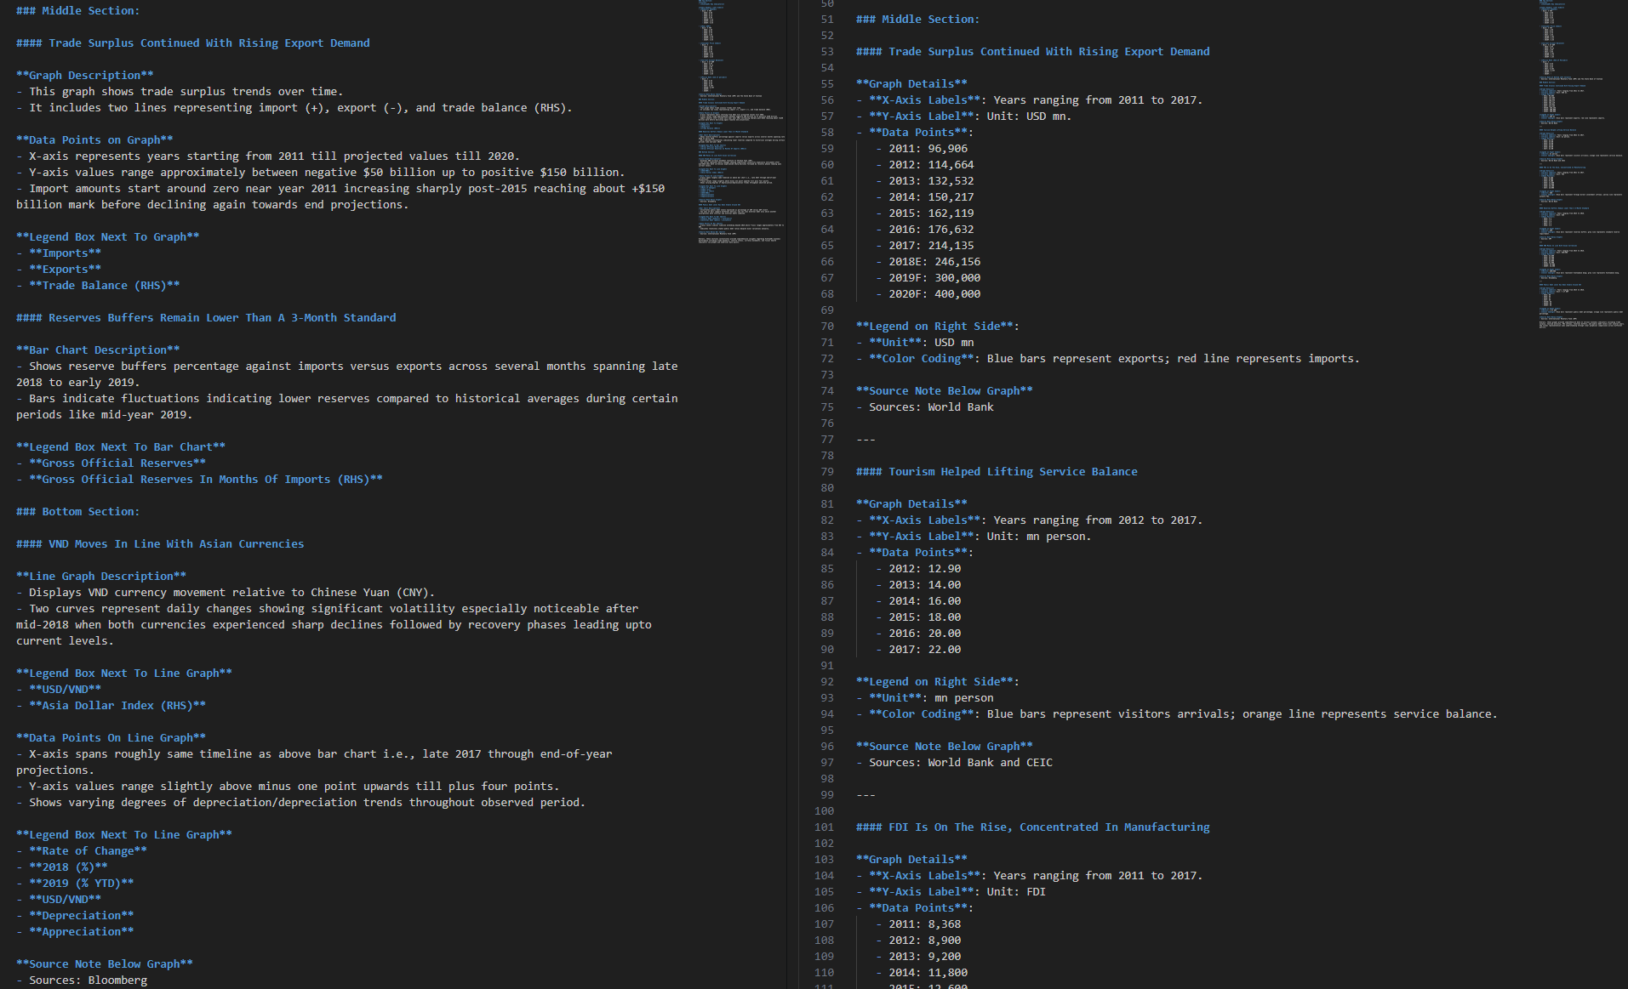
Resolution mode in DeepSeek-OCR
Base mode
Gundam mode

Slide 28
Phase 4: Prompt template for chart, plot, and trend
Role: You are a professional data annotator and senior economic analyst.
Task: Analyze the provided image and generate a structured description. The image may contain economic charts, graphs, or data tables.
Instructions:
1. **Strict Formatting**: You must follow the "Output Template" below exactly. Do not deviate from the structure.
2. **Multi-Chart Handling**: If the image contains multiple graphs (e.g., quadrants or a dashboard layout), categorize them logically into "Top Section," "Middle Section," or "Bottom Section." Repeat the detailed analysis block (from "Graph title" to "Source Note") for *each* individual graph found within that section.
3. **Language Processing**: The image may contain Thai text. You must translate any Thai labels, titles, or notes into English for this description. Ensure economic terms are translated accurately (e.g., "ดุลบัญชีเดินสะพัด" -> "Current Account Balance").
4. **Data Precision**: When extracting "Remarkable points" and "Data Points," use the exact numbers visible. If values are estimated from the axis, state them clearly.
**Output Template:**

Slide 29
Phase 4: Prompt template for chart, plot, and trend
Introduction: [Explain the overall image and its main title]
### Top / Middle / Bottom section:
#### [Graph title]
**Graph description**
**Chart type:** [e.g., line, bar, combination line & bar, donut, pie, scatter, waterfall, bubble, area]
**Visual structure:** [Describe how the data is organized, e.g., Bars represent GDP while the line represents inflation]
**Relationship:** [e.g., linear, curvilinear, exponential, logarithmic, cyclic, sigmoidal, parabola, no apparent correlation]
**Remarkable point**
**Extrema:** [Identify the highest value and lowest value with their specific dates/categories]
**Latest Status:** [Explicitly state the value of the *most recent* data point shown]
**Trend Dynamics:** [e.g., "upward trend with high volatility," "sharp V-shaped recovery," "plateauing after a surge"]
**Data points on graph**
**X-axis:** [Identify the domain, e.g., time-series (start year to end year), categorical (list the main categories)]
**Y-axis:** [Identify the range and units, e.g., Left axis…, Right axis…]
**Legend box** [Distinguish between the different categories]
**Source note below graph** [If applicable]
Summary: [Provide summary of the main insight derived from this entire image]

Slide 30
Phase 4: Prompt template for HTML table
Convert the following document to markdown.
Return only the markdown with no explanation text. Do not include delimiters like ```markdown or ```html.
Rules:
- You must include all information on the page. Do not exclude headers, footers, or subtext.
- Return tables in an HTML format.
- Charts & infographics must be interpreted to a markdown format. Prefer table format when applicable.
- Prefer using ☐ and ☑ for check boxes.

